Slide 1

Section 1
Babbacombe Bay Café
description and evaluation
https://babbacombebaycafe.co.uk/
Notes:
Babbacombe Bay Café’s website aims to attract customers by providing essential information like menus, location, opening hours and booking options.

Slide 2





Babbacombe Bay Café Website
Menus
Location
Opening hours
Booking
Notes:
Babbacombe Bay Café’s is a website aiming to attract customers to the café and provide them with essential information
Such as menus,
location,
opening hours
and booking options.

Slide 3
User Goals - All
Find location
Check its dog friendly
View menu
Find contact information
View prices
Find outside catering information
Dietary requirements
View about us of café
View images
View customer reviews
Check times for set menus
View social media updates
Check opening hours
Find social media links
Find voucher information
Book a table
Notes:
To evaluate the website I found 16 user goals from across all pages

Slide 4

User Goals – Common
Find location
Check its dog friendly
View menu
Find contact information
View prices
Find outside catering information
Primary
Secondary
Dietary requirements
View about us of café
View images
View customer reviews
Check times for set menus
View social media updates
Check opening hours
Find social media links
Find voucher information
Book a table
Notes:
Which I categorised into primary goals and secondary goals.
The primary goals are the most important as these are the common goals the user will be trying to achieve

Slide 5

Task Scenarios - Creation
Who:
Is performing the task?
What:
Are they trying to achieve?
Where:
On the website?
When:
Would they do this?
Why:
Is it important?
How:
Would they complete it?
Notes:
I considered these questions
Who
What
Where
When
Why
And How.
To create test scenarios which mimic real user behaviour

Slide 6
Task Scenarios
Finding Basic Information
Check Opening Hours: You want to visit the café this Saturday for breakfast. Find the opening hours for Saturdays.
Locate Contact Details: You need to book a table for 4 people tomorrow evening. Find the phone number or email to contact the café.
Find the Location: You are going to the café for the first time. Locate the address or map showing its location.
Exploring the menu
Finding the Menu: You are planning to visit the café and want to check if they offer vegan desserts. Find the menu and identify if vegan options are available.
Finding Prices: You are planning to have afternoon tea at the café and want to know the cost of a high tea. Find the menu and locate the price for the high tea.
Identify Dietary Info: You are lactose intolerant and can’t have dairy. Check if there are dairy free options available.
Booking a Table
Book a Table: You want to reserve a table for two this Friday at 7PM. Use the website to make a booking.
General
Navigate to Social Media: You want to see other peoples reviews of the cafe’s dishes. Find and open their Instagram or Facebook page.
Explore Special Offers: Your friend’s birthday is approaching and you heard that the café offers vouchers which you can gift. Find out information about the voucher and how you can order one.
Notes:
The goal being to use the scenarios to help identify problem areas in the café’s website
I then conducted a mock evaluation with peers using these scenarios.
Asking questions about how they found the experience and taking notes of any reactions, hesitation or struggles during.

Slide 7

Mock Evaluation
User Goals
Task Scenarios
Mock Evaluation
Survey Creation
Notes:
And used the findings to shape the main survey.
For example
The mock highlighted that some users struggled to get an immediate idea of the cafes location due to the map being too zoomed out.
So I added a question to the survey regarding the map and how the users felt about its usefulness.

Slide 8
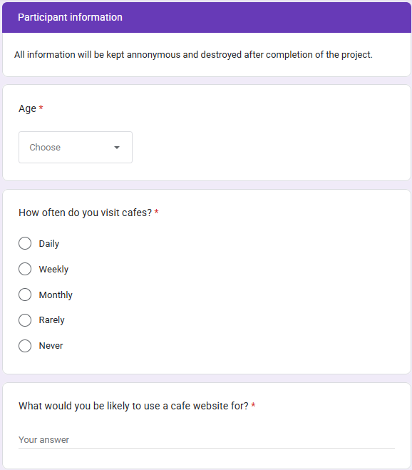
Survey – Participant Information
https://forms.gle/BxnRmUGZQSa1D5Zo8
Notes:
Here are the survey questions which I will quickly show.
So pause if you would like to read them.

Slide 9
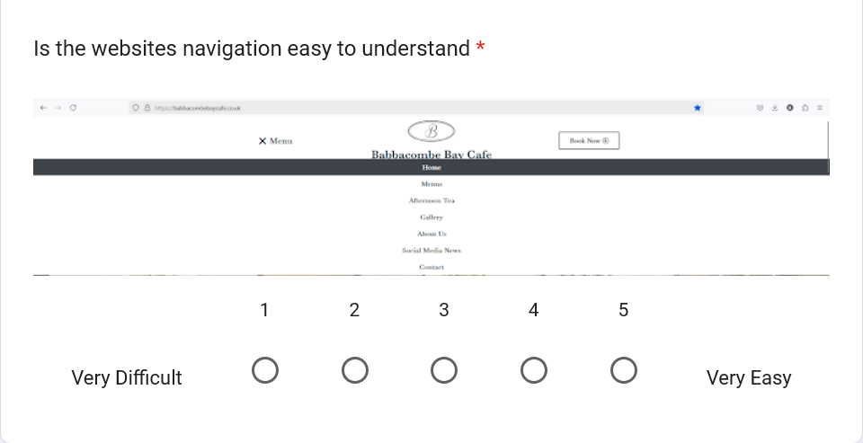
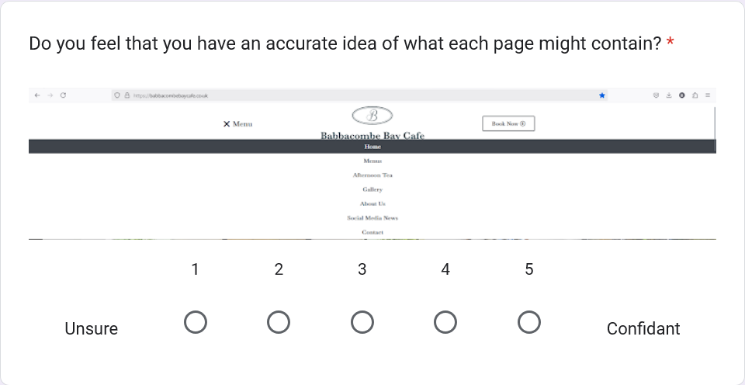
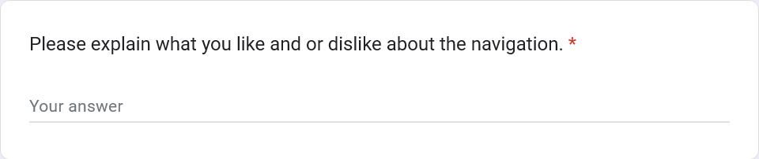
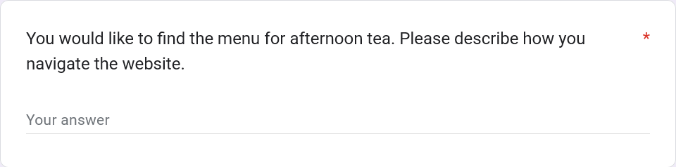
Survey - Navigation
1.
3.
4.
2.

Slide 10
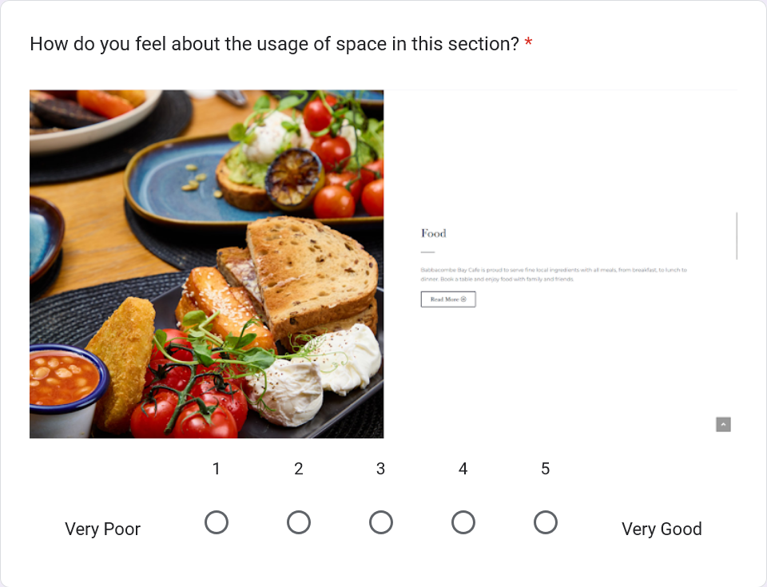
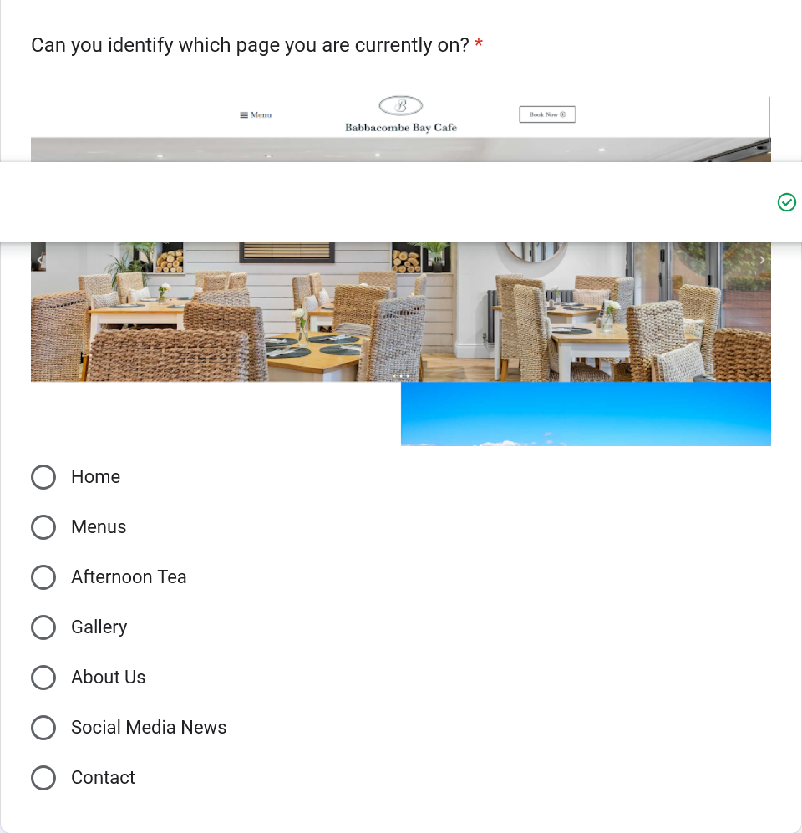
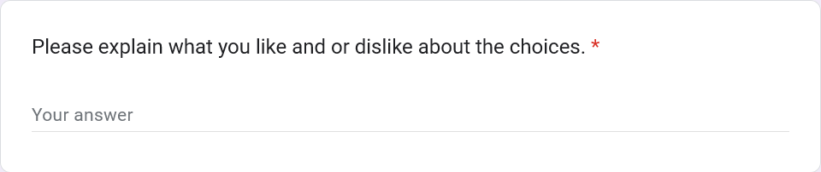
Survey - Pages
4.
5.
6.

Slide 11
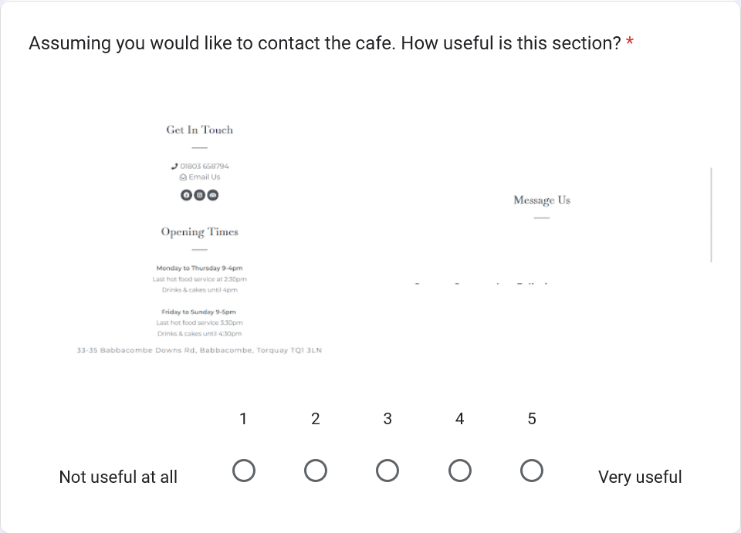
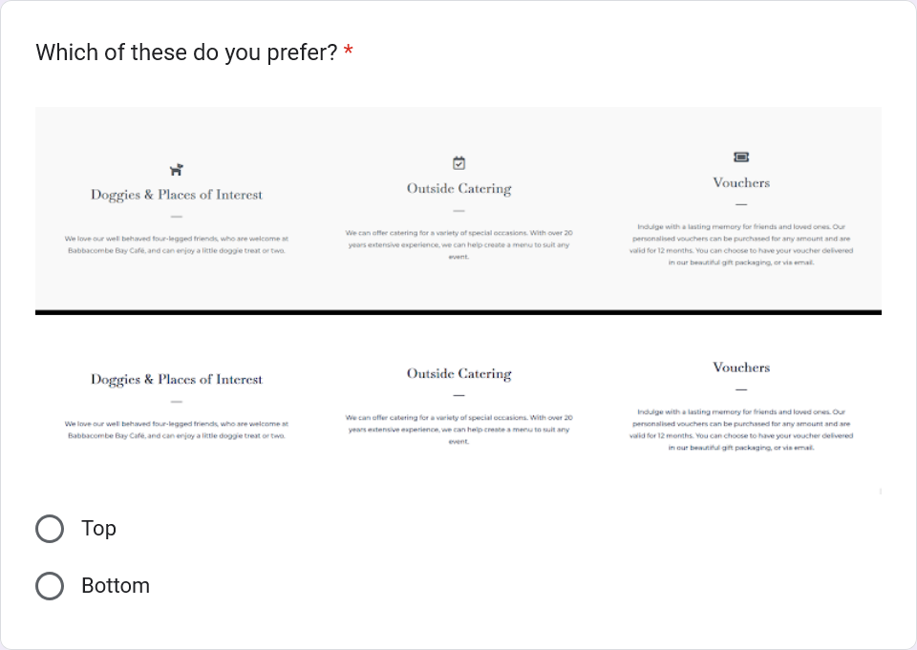
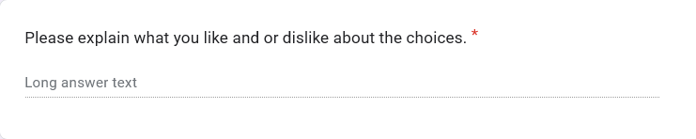
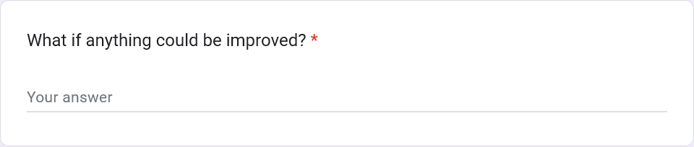
Survey - Pages
9.
7.
10.
8.

Slide 12
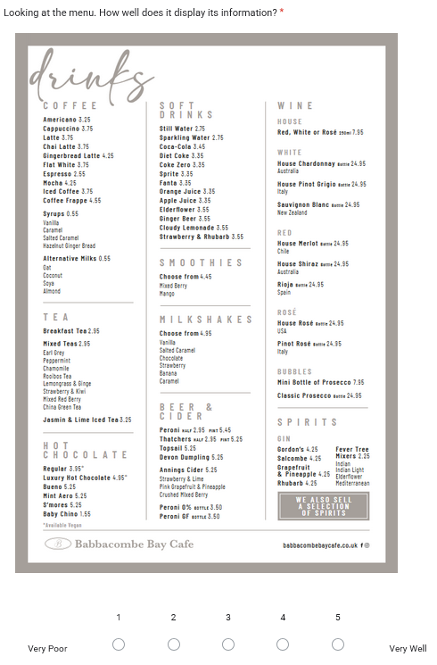
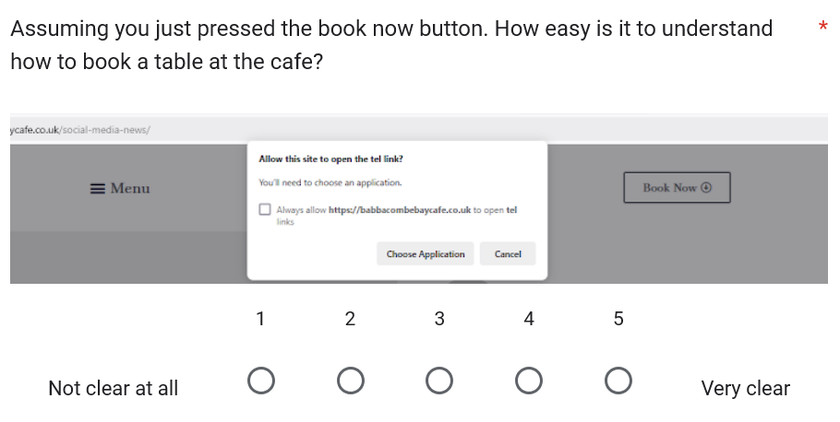
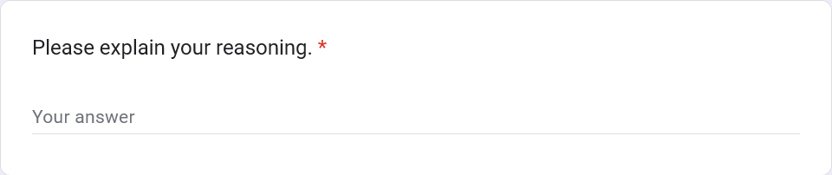
Survey - Pages
13.
11.
12.

Slide 13
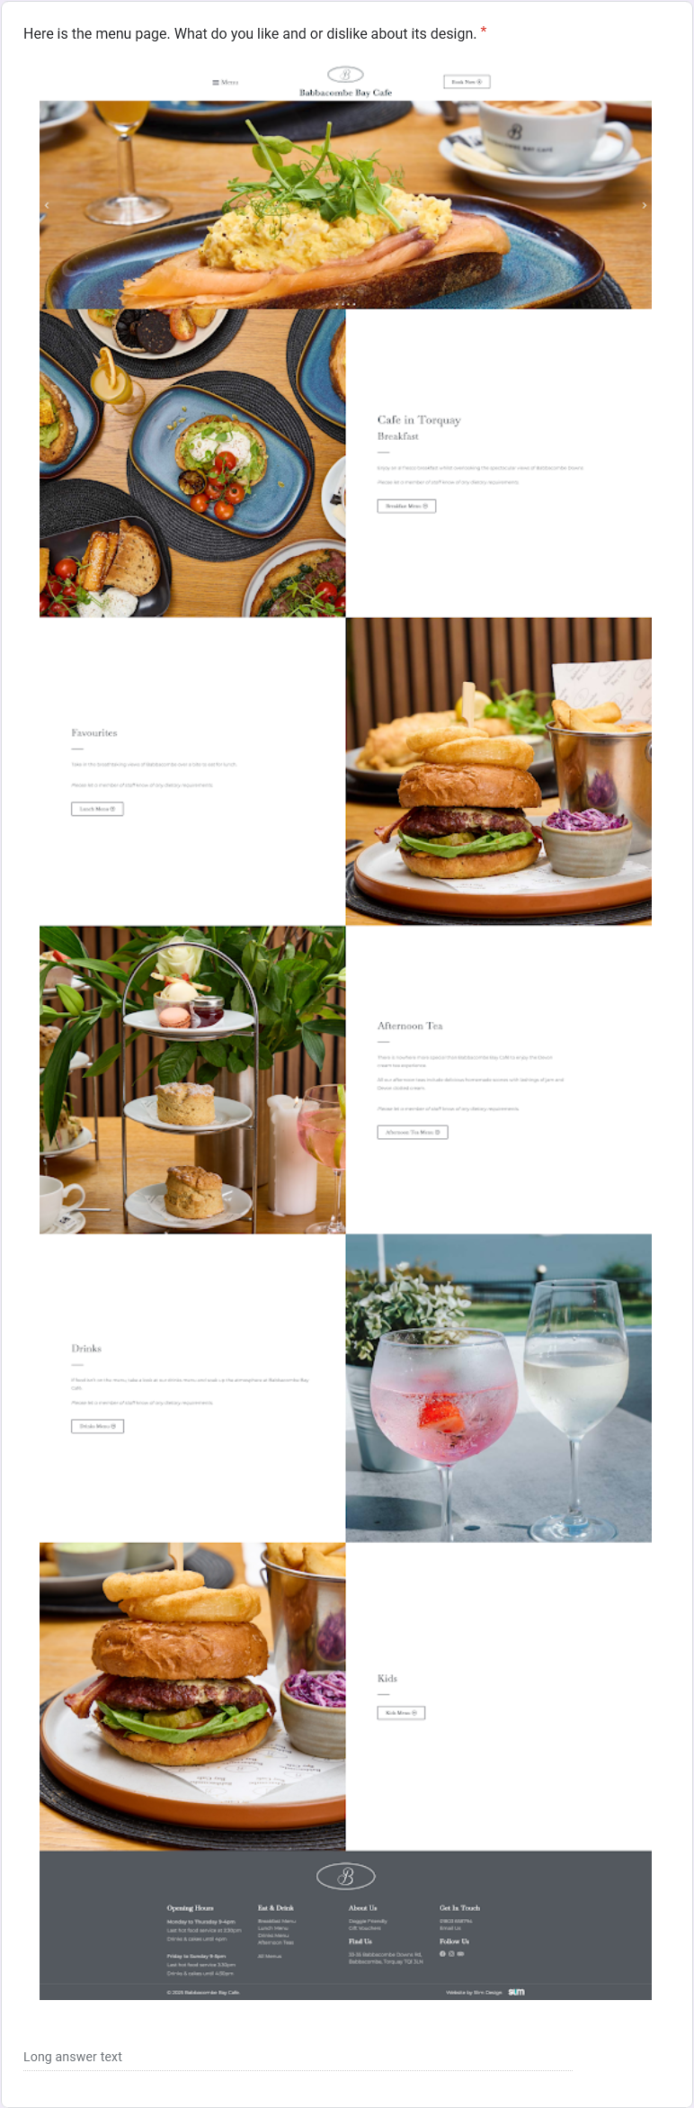
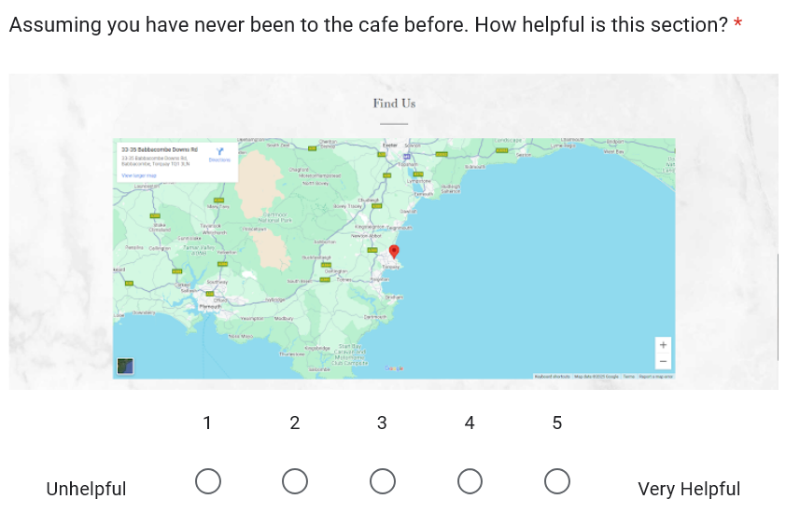
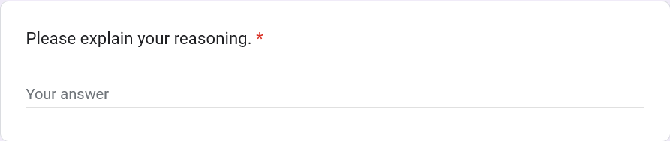
Survey - Pages
16.
14.
15.

Slide 14
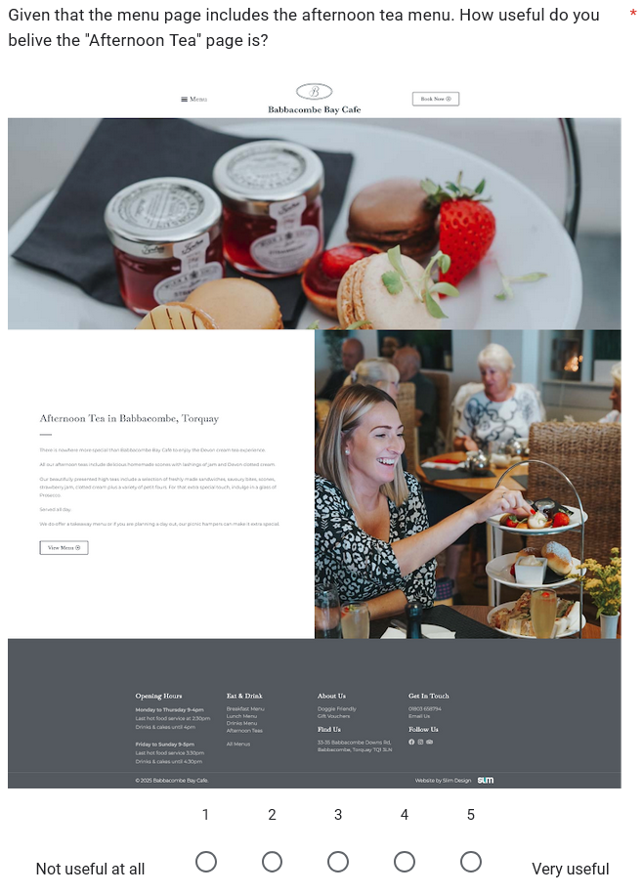
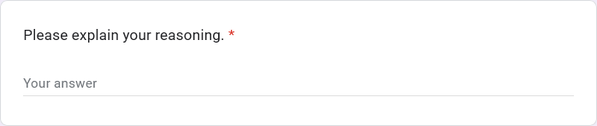
Survey - Pages
17.
18.

Slide 15
Participants
Anonymous Responses
Anonymous feedback encouraged honesty
11 Participants
Café Visit Frequency
8 aged 18-25
1 aged 25-35
1 aged 55-65
4 rarely visit cafés
3 visit monthly
4 visit weekly
Computer Literacy
Potential Bias
All participants were tech proficient
Allowing for detailed and informed feedback
Dominance of 18-25 age range
Tech proficient feedback doesn’t reflect average user
Notes:
All feedback from the survey was anonymous,
With all of the participants being proficient in technology
Which is good for gathering informed feedback however it could potentially introduce biases

Slide 16
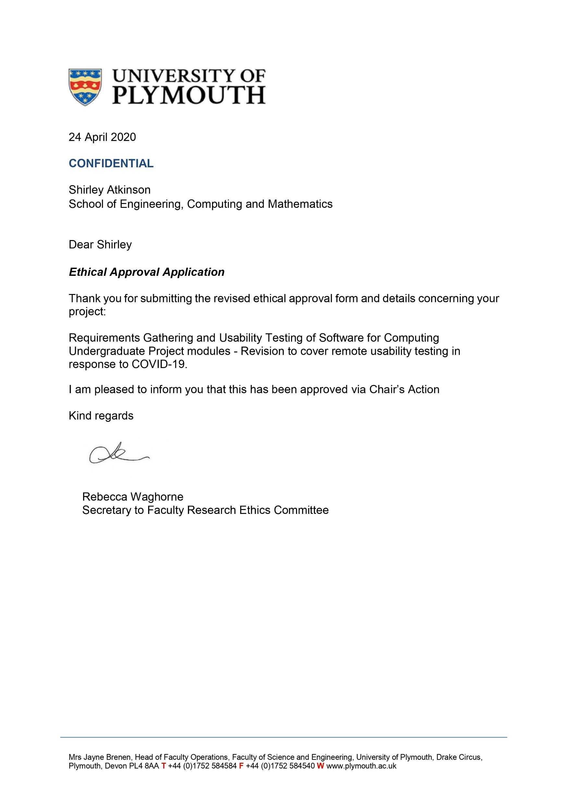
Documentation
University of Plymouth Ethics Approval
Research Information sheet
Right to Withdraw
Ethics Consent Form
Task Scenarios
Exit questionnaire
Notes:
Now onto the documentation.
Please pause to read.

Slide 17
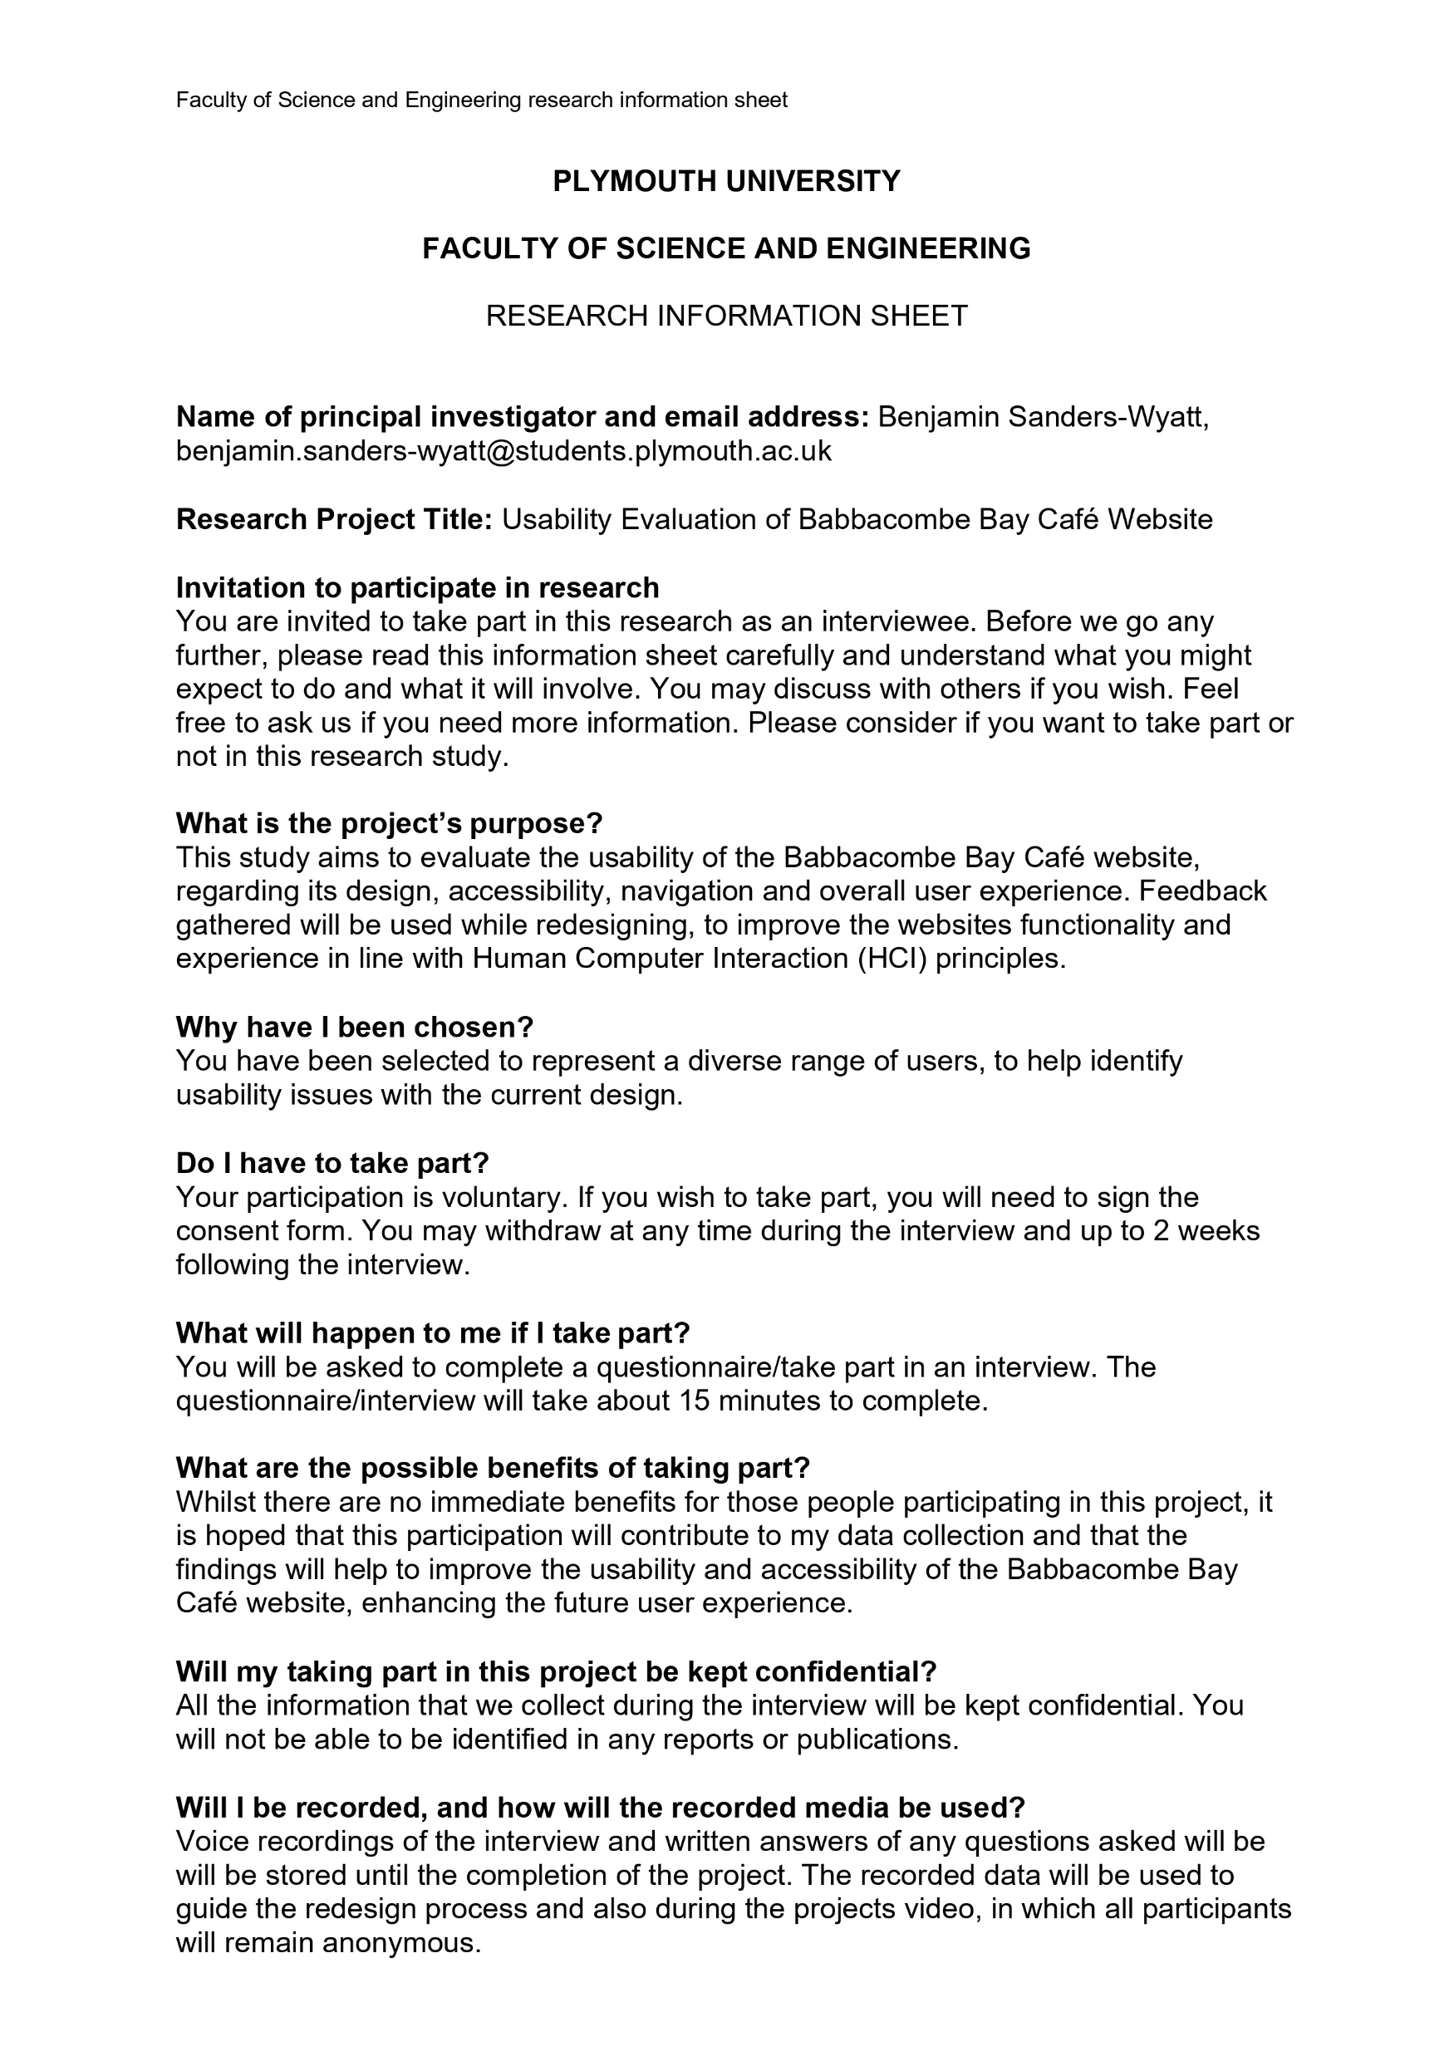
Documentation
University of Plymouth Ethics Approval
Research Information sheet
Right to Withdraw
Ethics Consent Form
Task Scenarios
Exit questionnaire

Slide 18
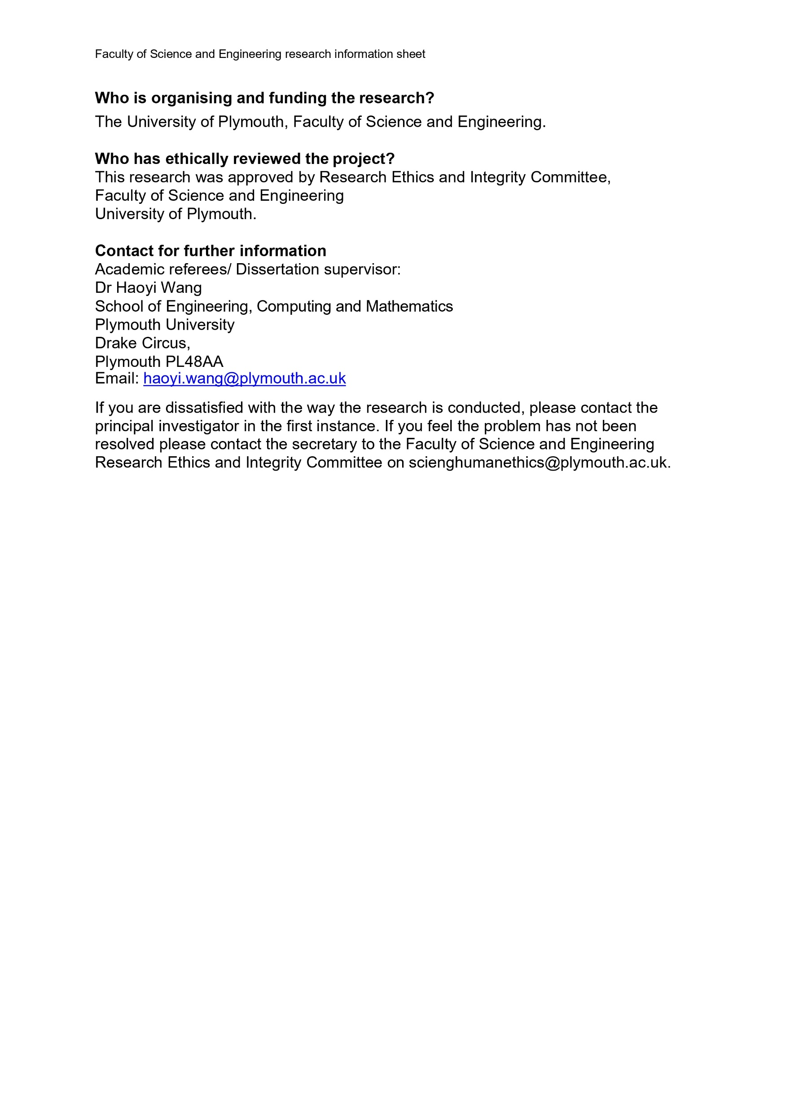
Documentation
University of Plymouth Ethics Approval
Research Information sheet
Right to Withdraw
Ethics Consent Form
Task Scenarios
Exit questionnaire

Slide 19
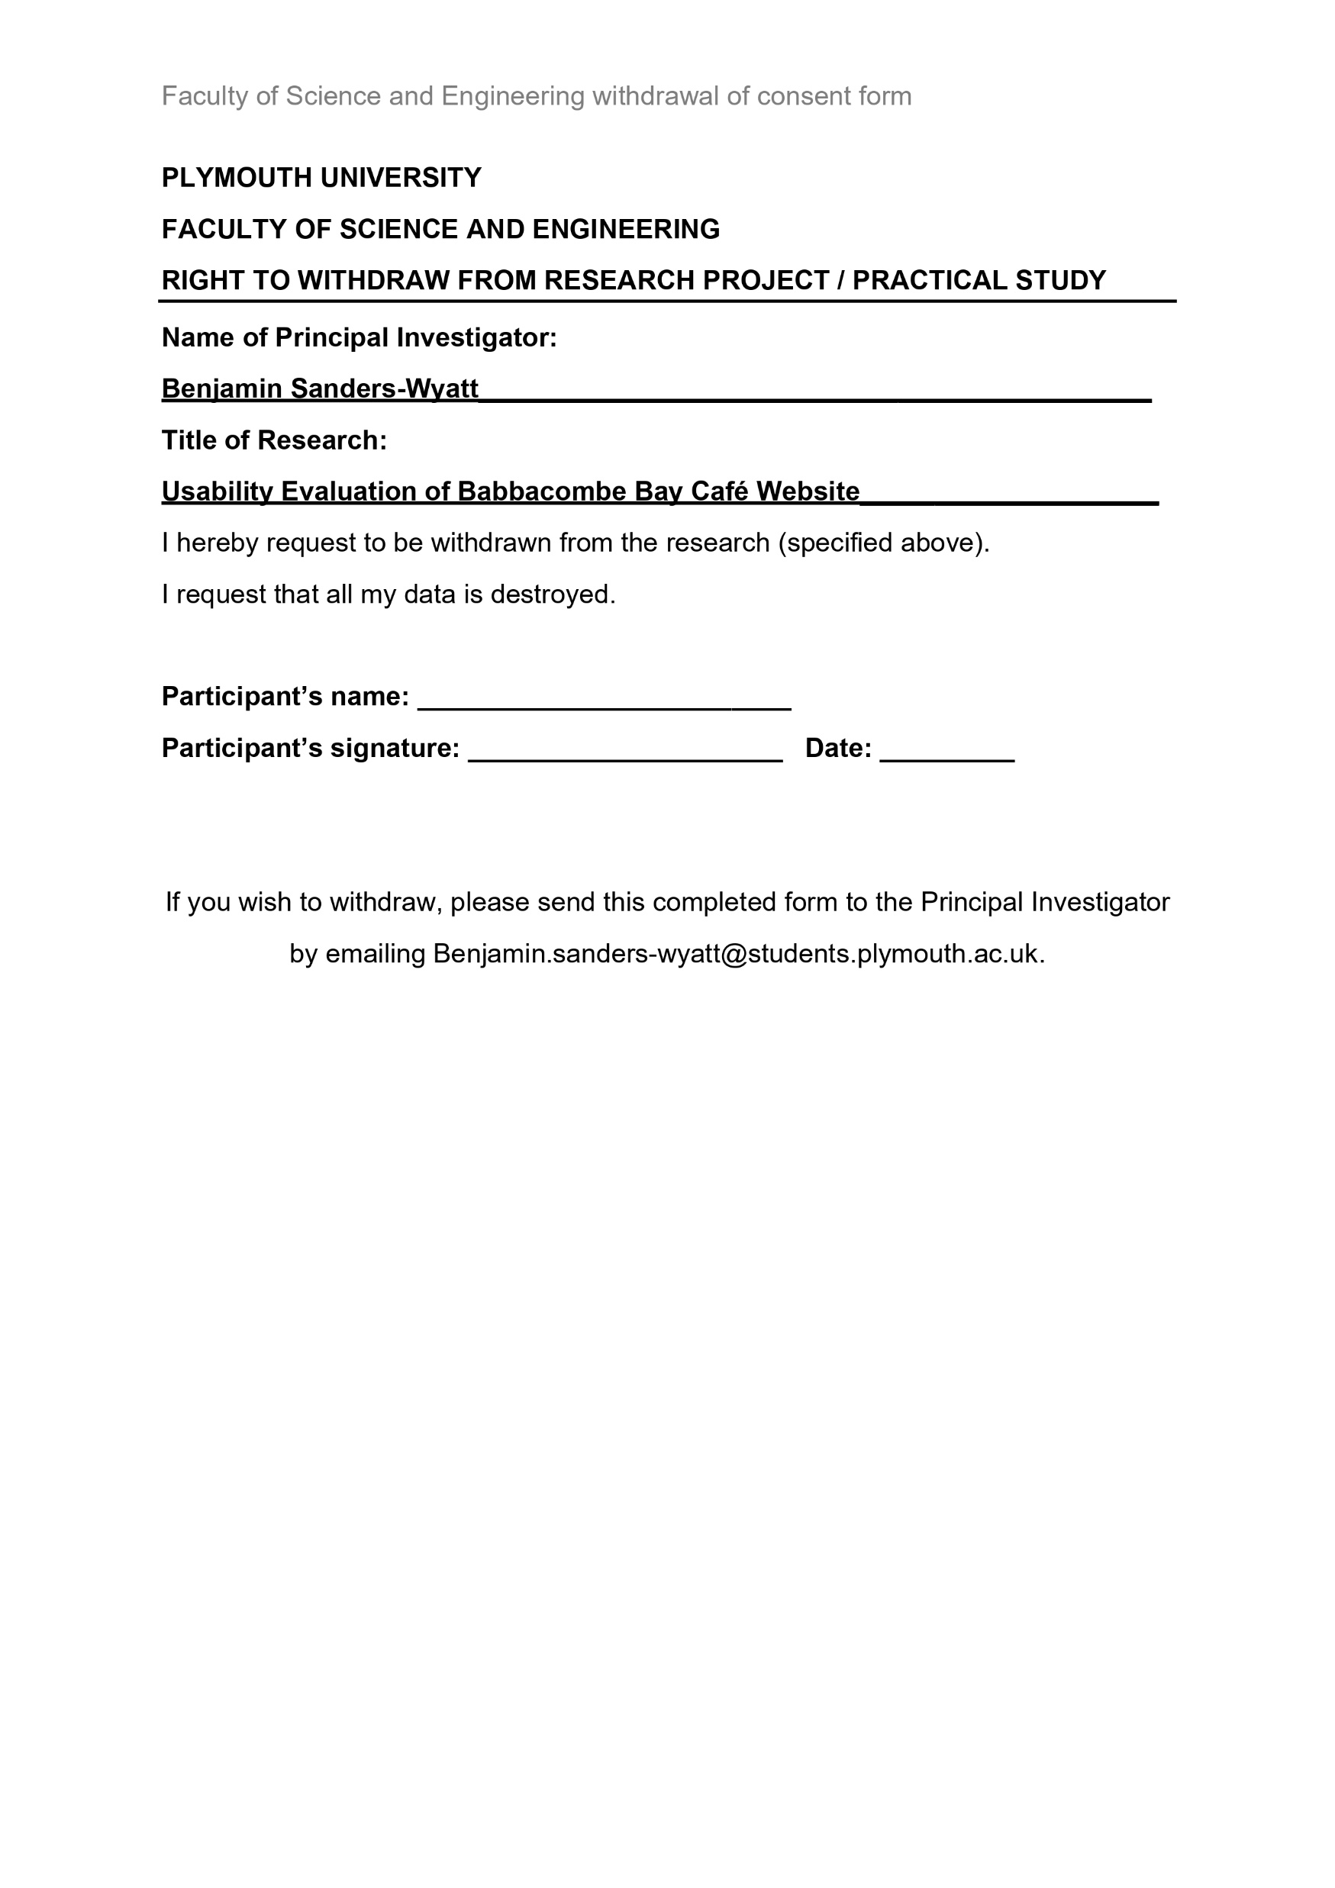
Documentation
University of Plymouth Ethics Approval
Research Information sheet
Right to Withdraw
Ethics Consent Form
Task Scenarios
Exit questionnaire

Slide 20
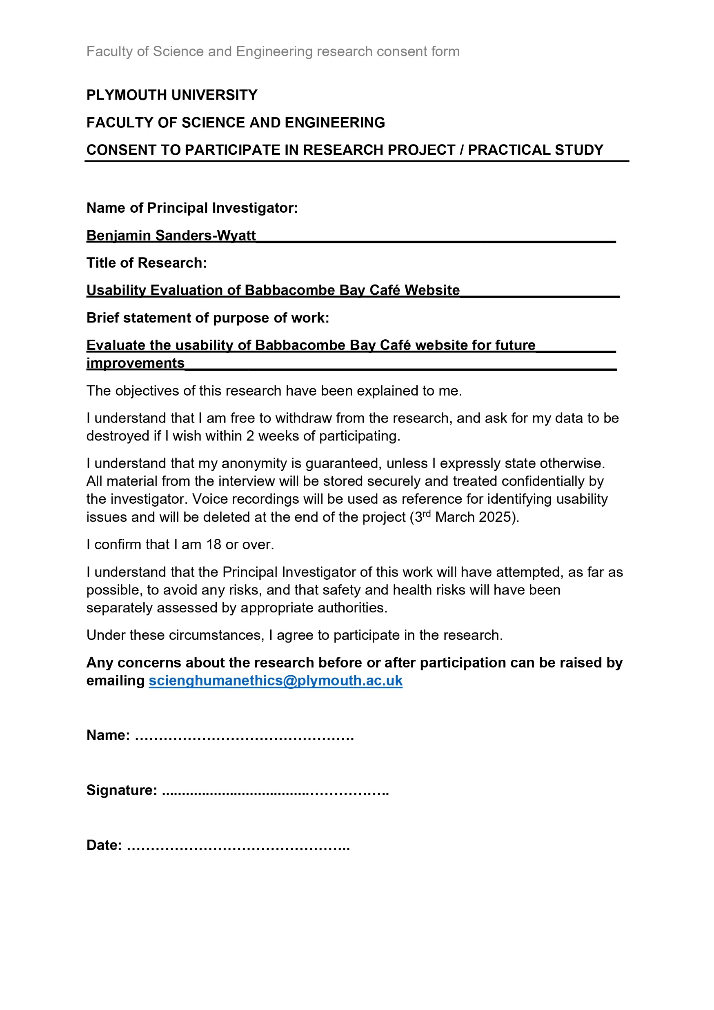
Documentation
University of Plymouth Ethics Approval
Research Information sheet
Right to Withdraw
Ethics Consent Form
Task Scenarios
Exit questionnaire

Slide 21
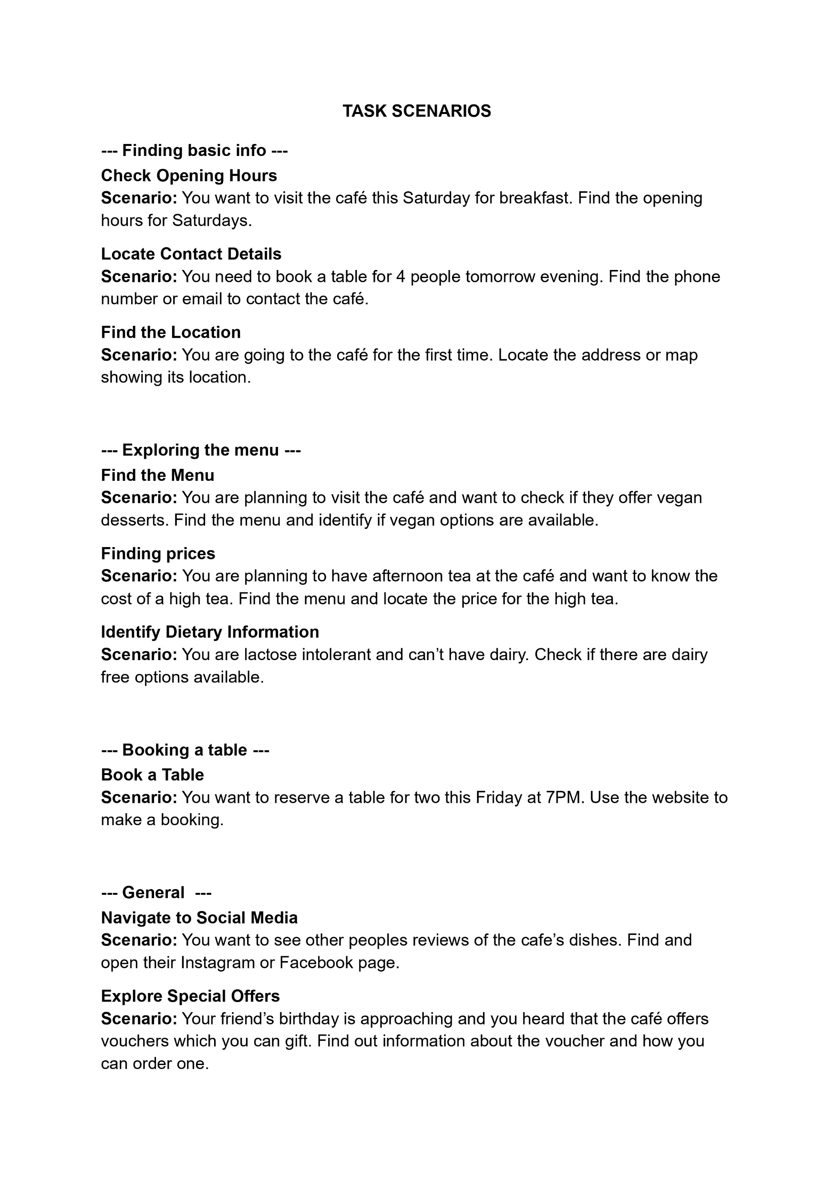
Documentation
University of Plymouth Ethics Approval
Research Information sheet
Right to Withdraw
Ethics Consent Form
Task Scenarios
Exit questionnaire

Slide 22
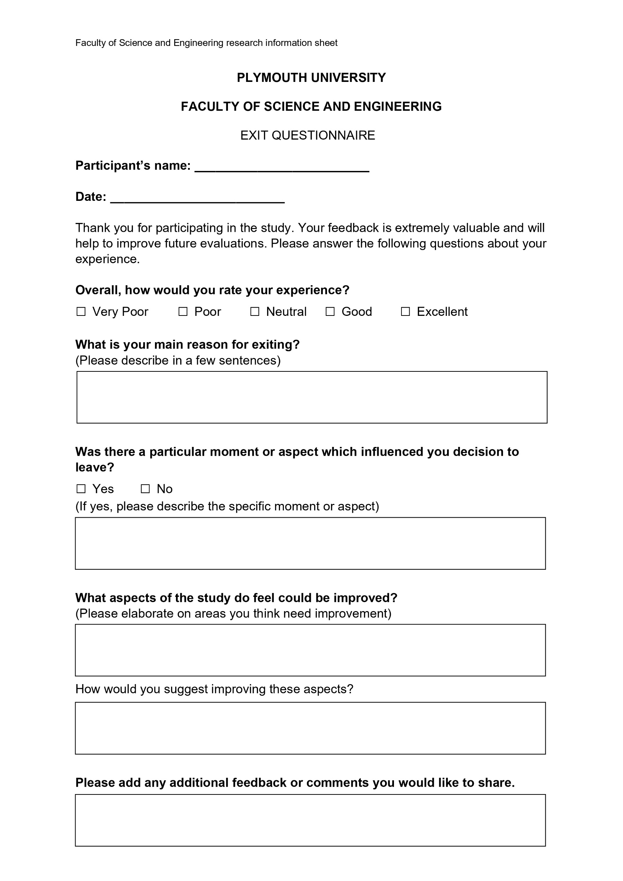
Documentation
University of Plymouth Ethics Approval
Research Information sheet
Right to Withdraw
Ethics Consent Form
Task Scenarios
Exit questionnaire

Slide 23
Section 2
Analysis and redesign process

Slide 24
Data Analysis - Quantitative
 | Mean | Median | Std Dev
Navigation Ease | 3.8 | 4 | 0.94
Page Titles Clarity | 4.3 | 5 | 0.86
Space Usage | 1.8 | 2 | 0.72
Contact Usefulness | 4.0 | 4 | 1.04
Book Now Button Clarity | 2.1 | 2 | 1.00
Menu Display | 4.6 | 5 | 0.88
Location Map | 4.4 | 5 | 0.88
Afternoon Tea Page Usefulness | 3.0 | 3 | 1.48
 | If Everyone Guessed | Accuracy
Page Identification | 14% | 45%
 | Prefer Top | Prefer Bottom
Info Bar Preference | 100% | 0%
Notes:
This is the quantitively data collected from the google forms survey.
The top table showing the mean and median averages along with the standard deviation of the results.
From this you can see that the space usage and book now page have low average scores and are problem points.
You can also see that the deviation in scores for the afternoon tea page usefulness is fairly high, meaning that opinions were mixed.
The participants only had a 45% accuracy for identifying the page they were currently on.
While this is better than if they guessed ideally the accuracy should be much greater.

Slide 25
Data Analysis
Quantitative
Quotes
Space usage
Book now button clarity
Afternoon tea pages usefulness
Page identification
Design inconsistency
“I it see an email”
“get in touch & message us aren’t in line with each other”
“im unsure on this application its trying to make me open”
“it may appear to look suspicious and they may just click off”
“it doesn’t look like a booking section”
“shows a general area but not the specific area”
Notes:
The qualitative feedback echoed the quantitative data in some parts
And brought to attention more issues the users were dealing with.
The quotes from the feedback show some of the problems users were having with the website

Slide 26
Issues Identified
Essential
Desirable
Booking process clarity
Reduce navigation menu space
Page identification
Reduce excessive empty space
Justify afternoon tea pages existence
About us & contact page seperate
Reduce menu image sizes
Info bar is inconsistency
Write email don’t link to open app
Start zoomed further into the map
Reduce Header image
Advertise vouchers
Advertise takeaway options
Rename mislabelled titles
Reorganise navigation menu
Notes:
From these results the identified issues were separated into two lists
The essential and desirable
Despite the mislabel titles and inconsistent designs across pages,
Users had greater issues with the usage of space rather than focusing on mislabelled elements,
This told me that the overall design was more important than specific details.

Slide 27
Issues Identified
Essential
Desirable
Booking process clarity
Reduce excessive empty space
Page identification
Justify afternoon tea pages existence
Reduce menu image sizes
Reduce navigation menu space
About us & contact page seperate
Rename mislabelled titles
Reduce Header image
Advertise vouchers
Advertise takeaway options
Reorganise navigation menu
Write email don’t link to open app
Start zoomed further into the map
Info bar is inconsistency
Notes:
These were then ordered by priority
with the most important at the top

Slide 28
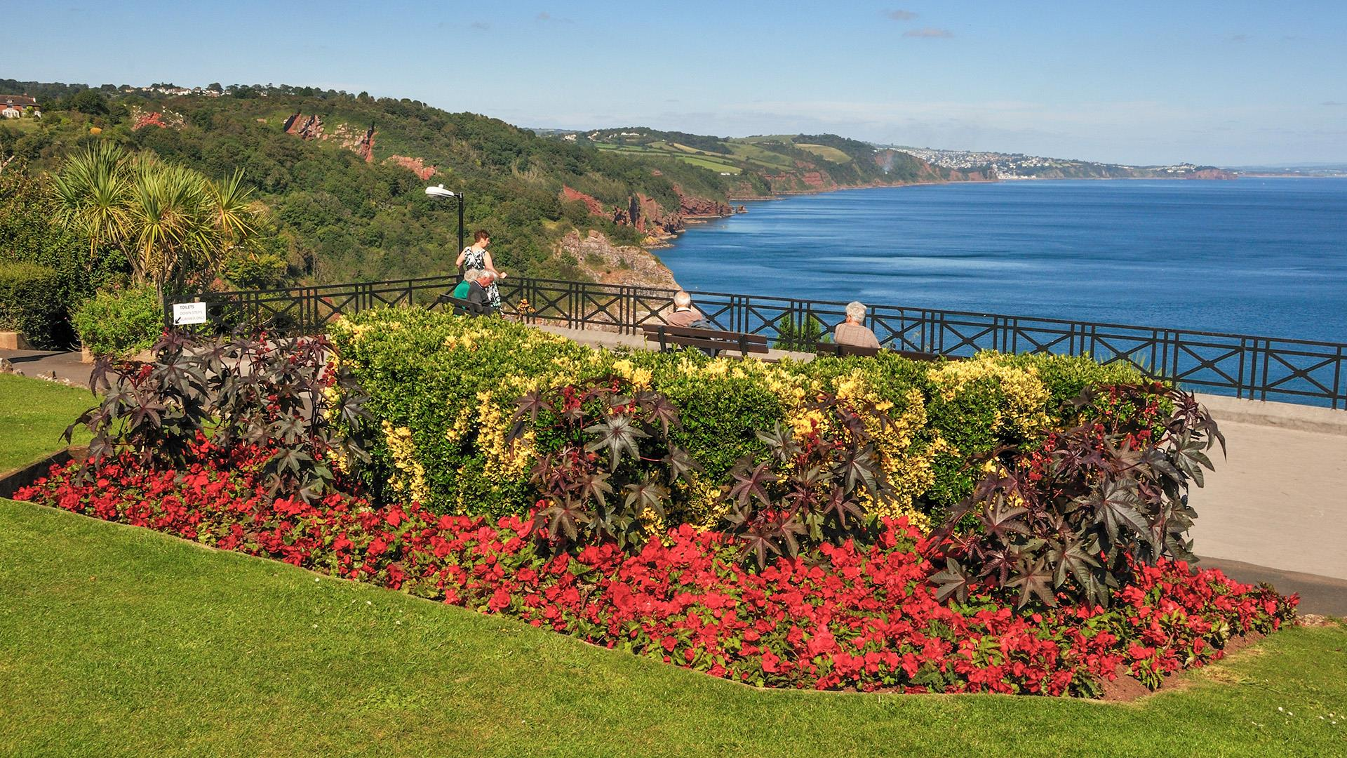
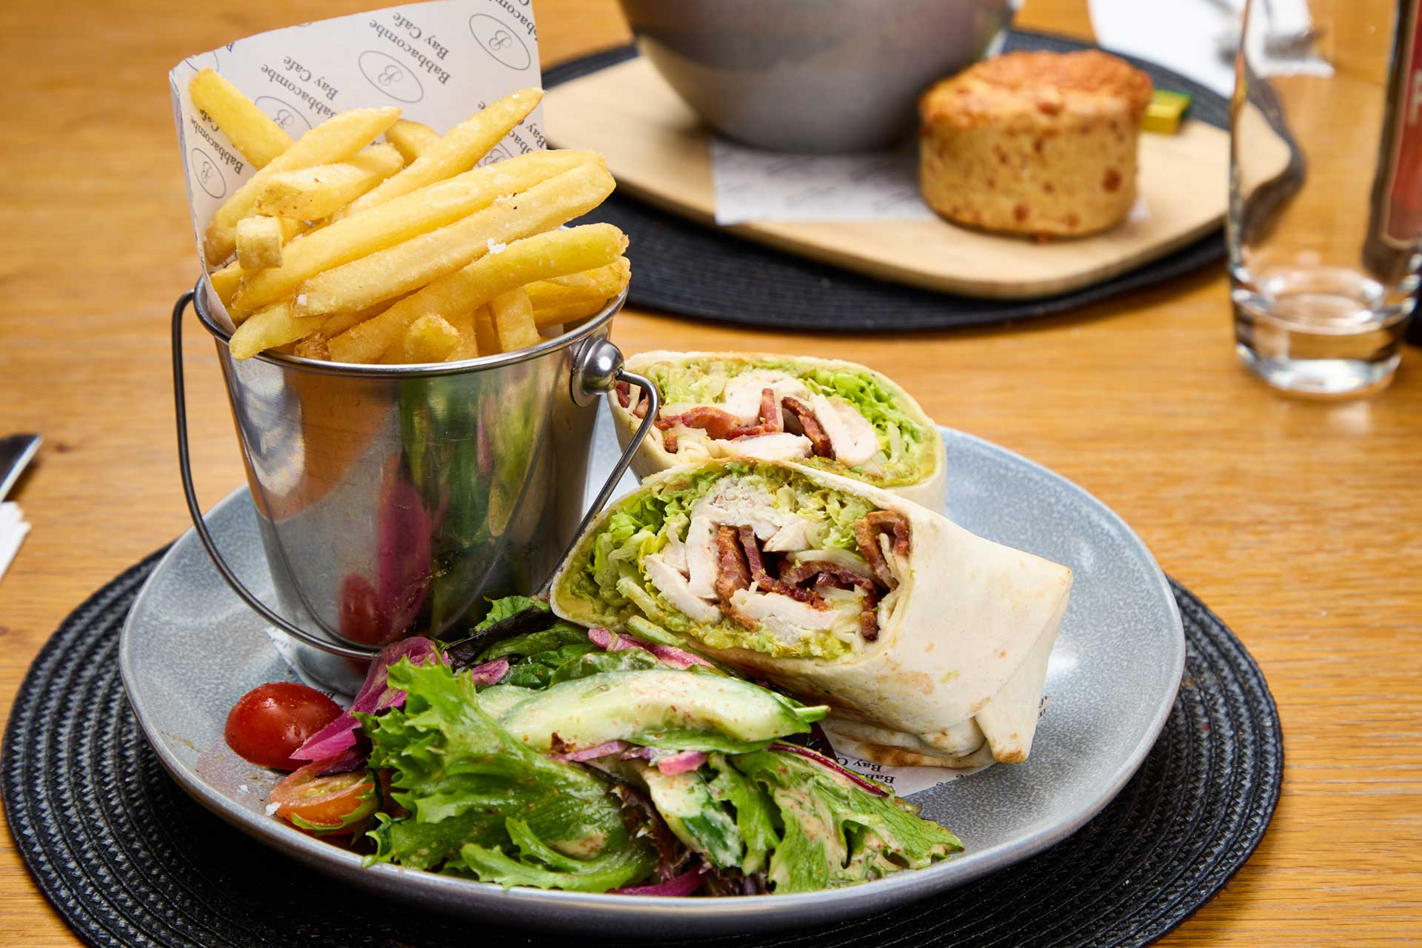
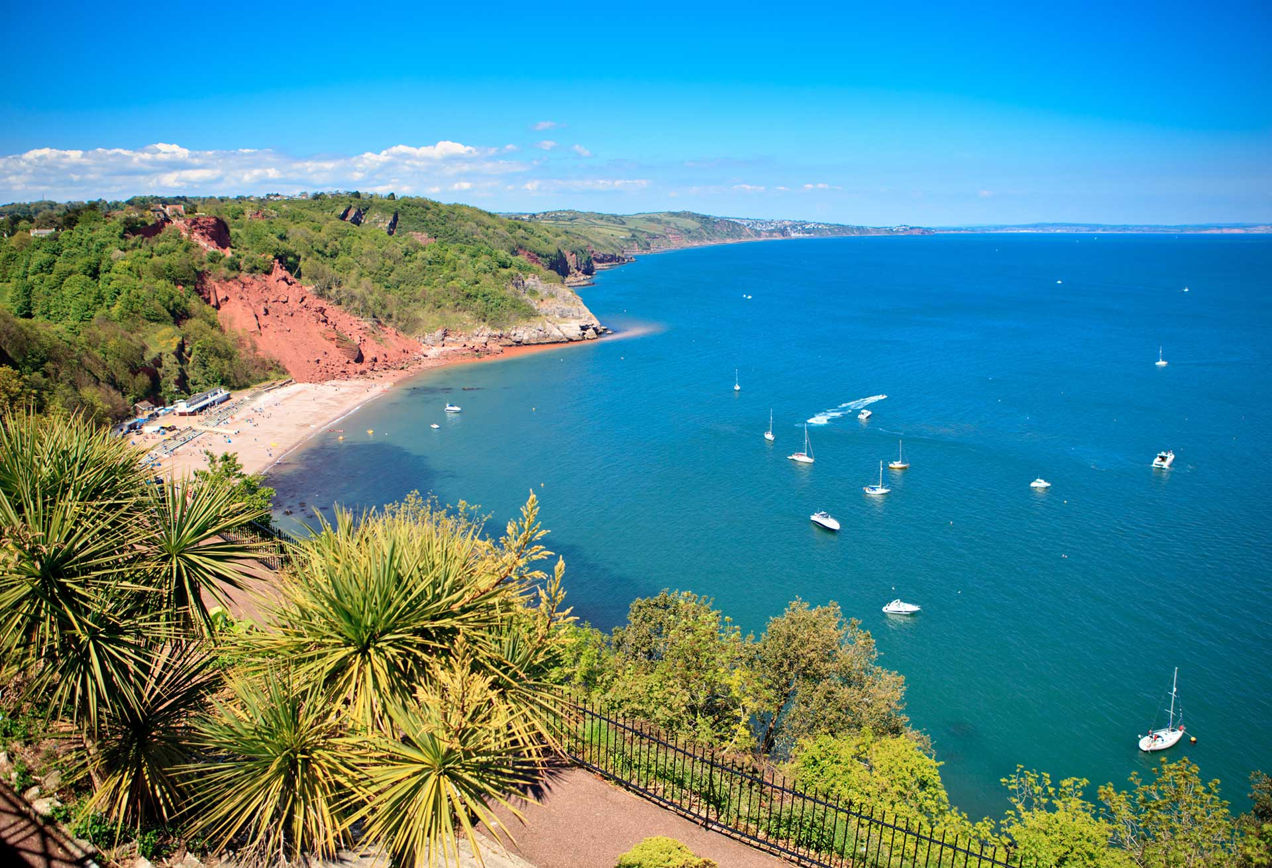
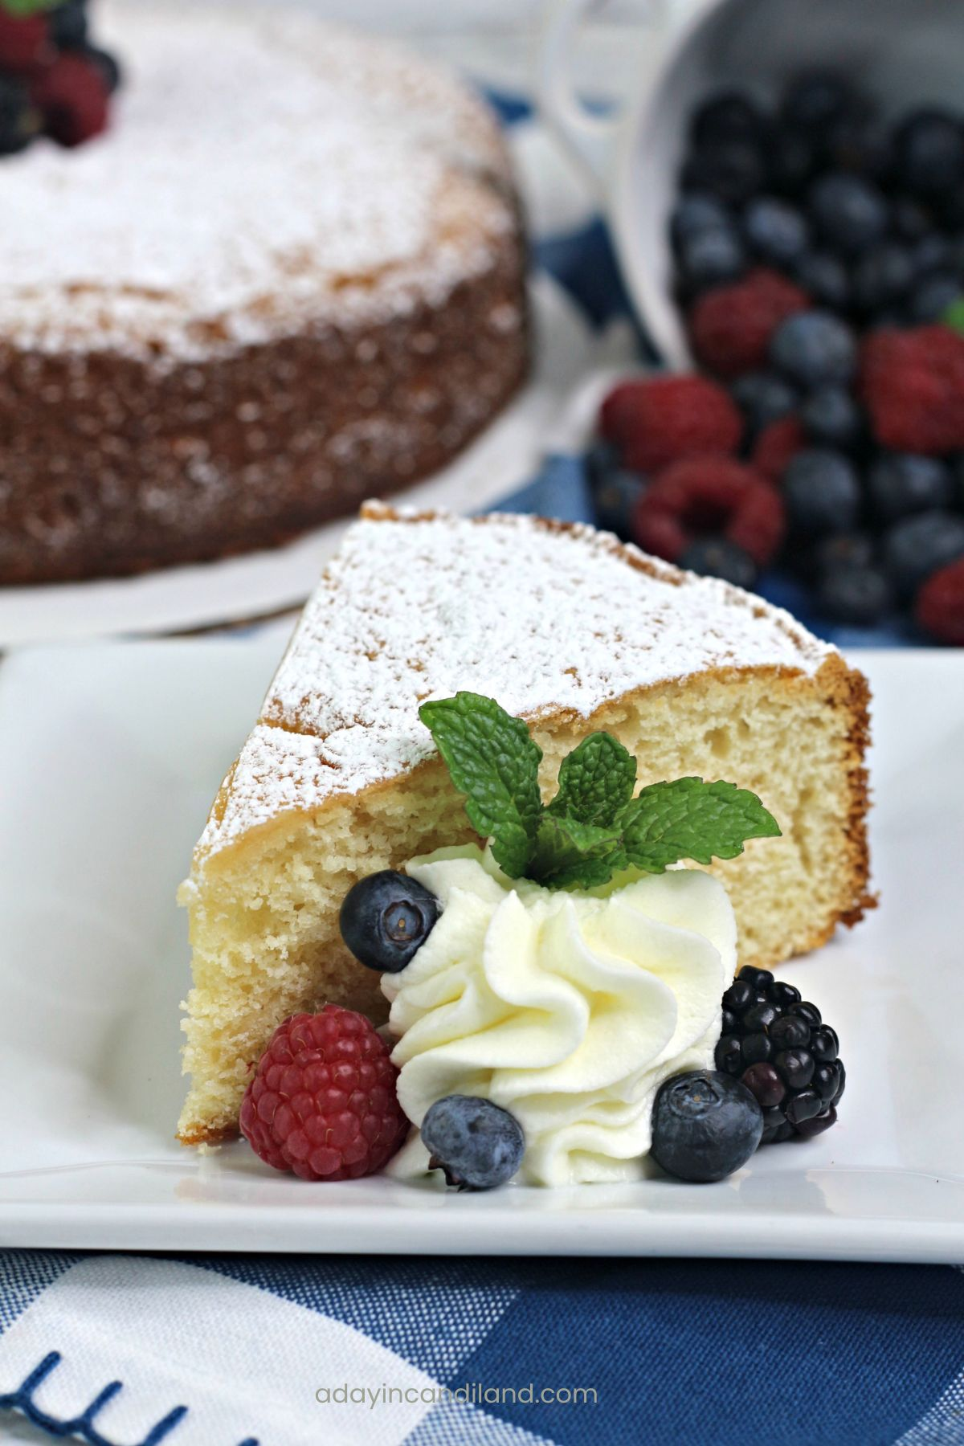
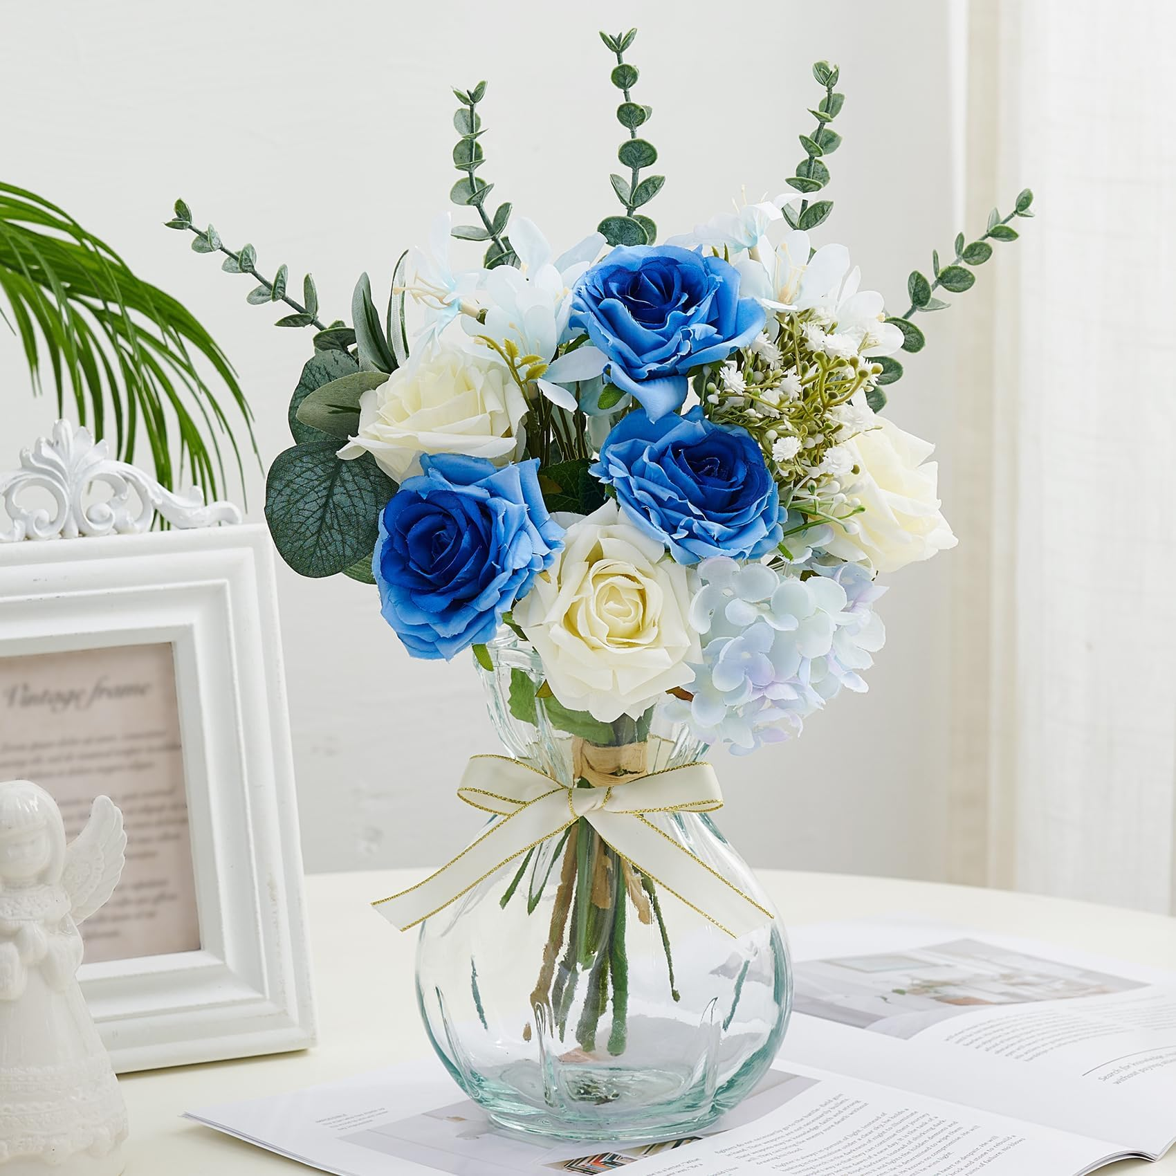
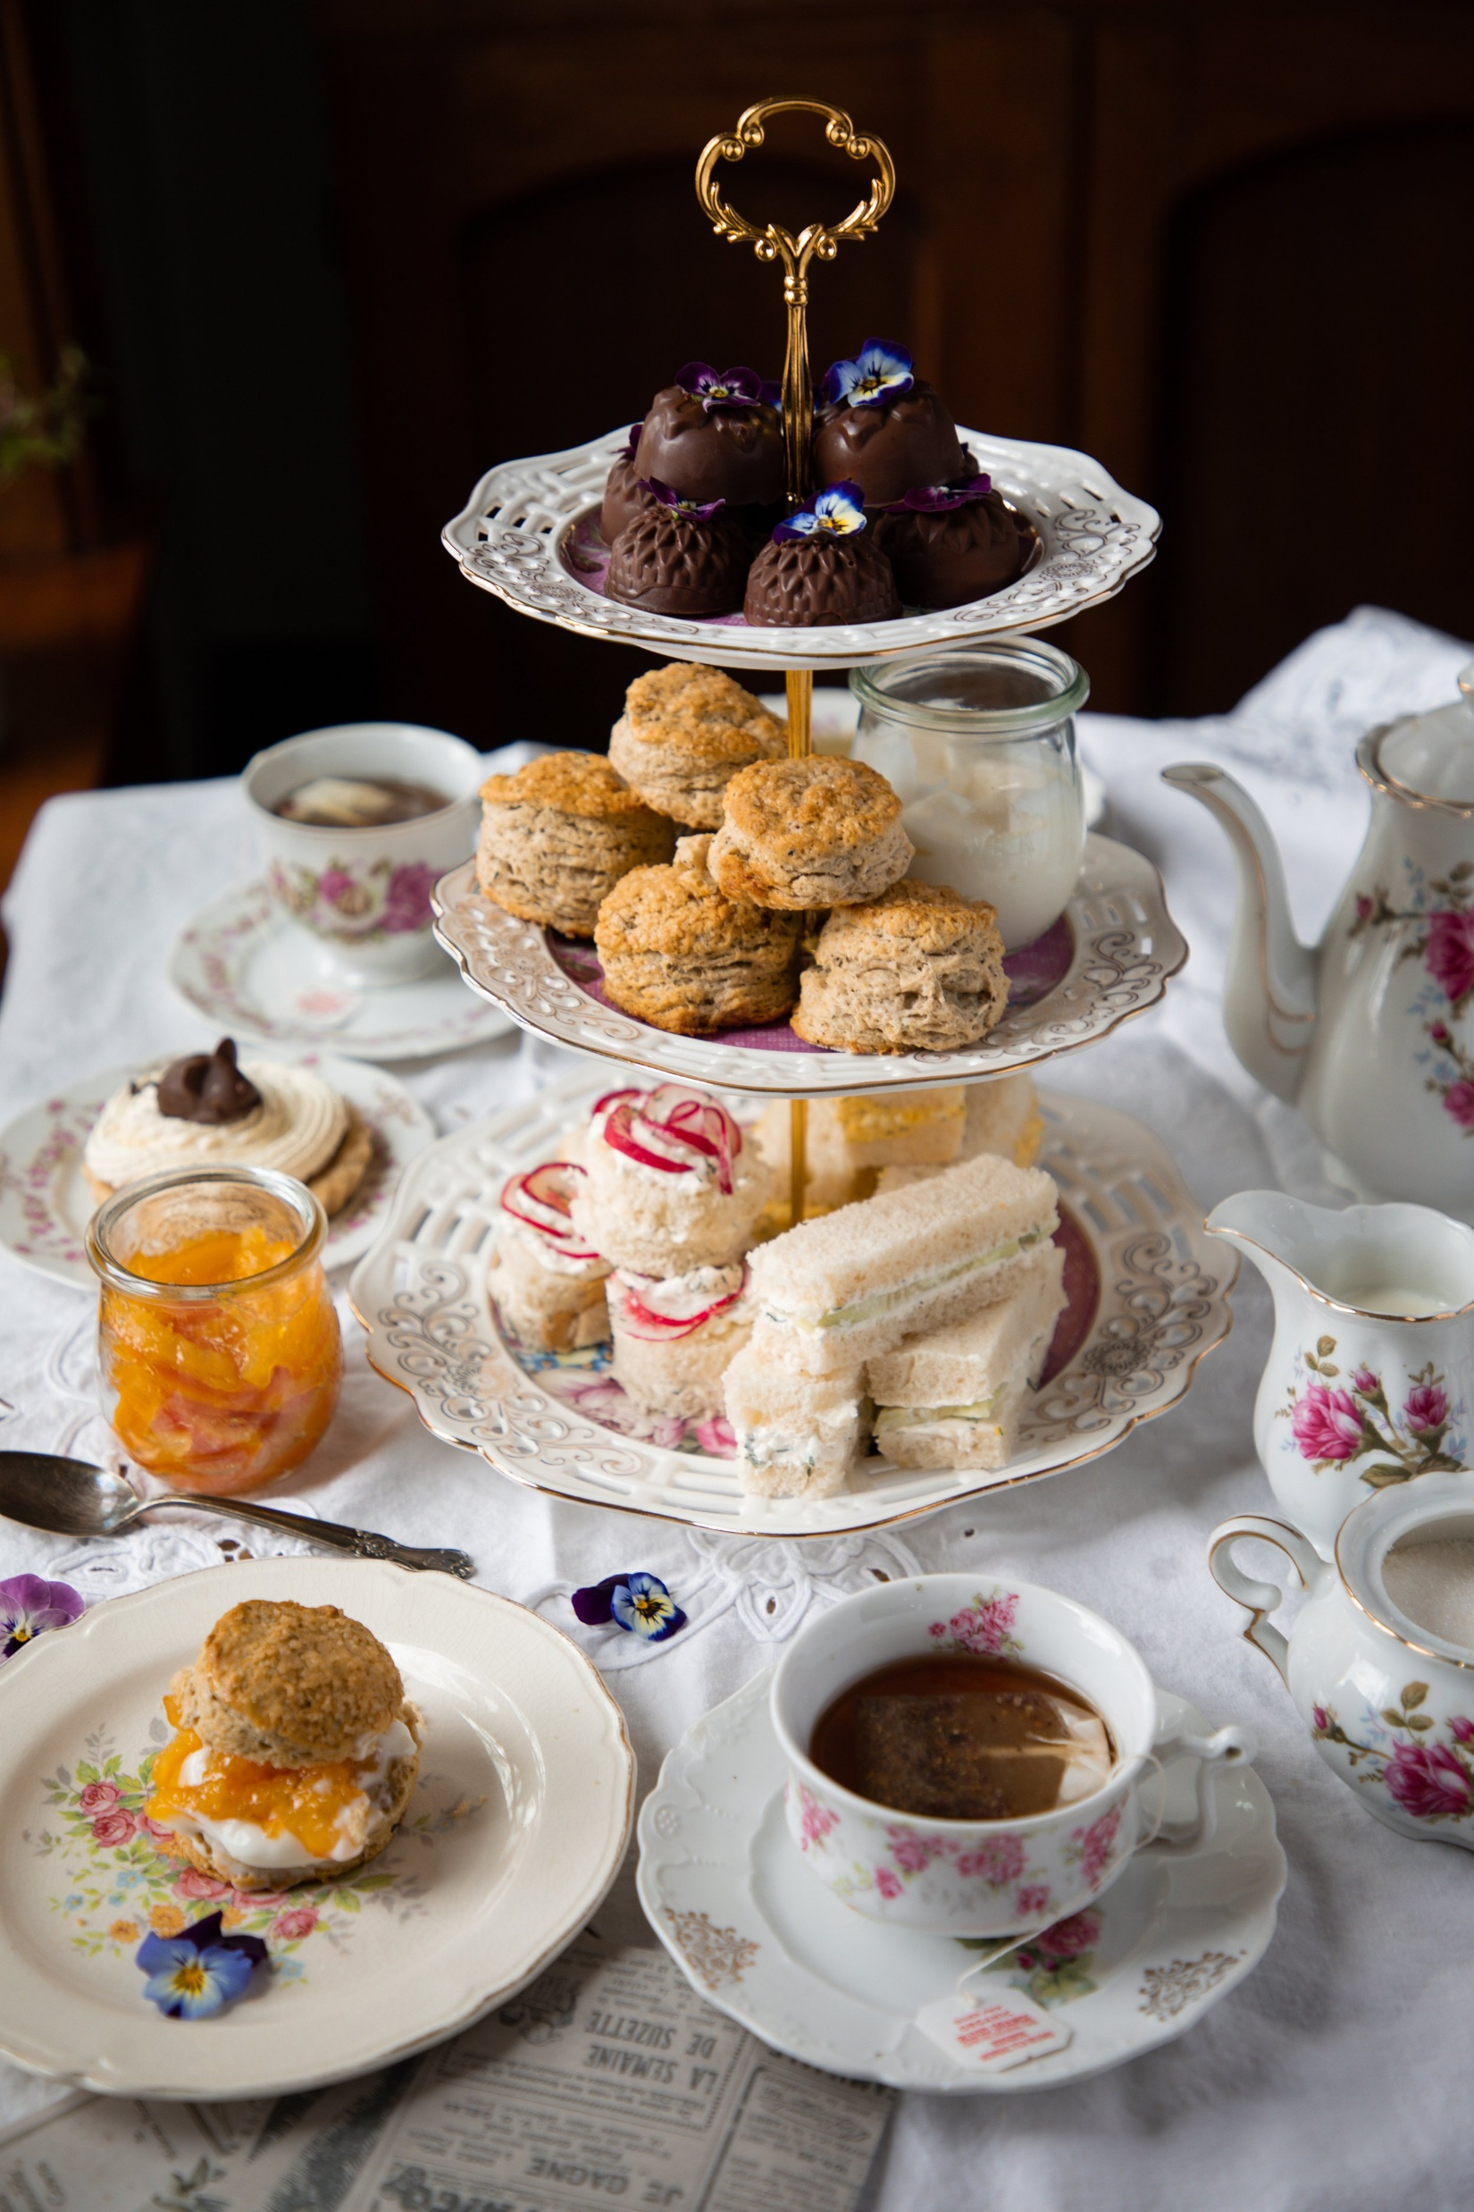
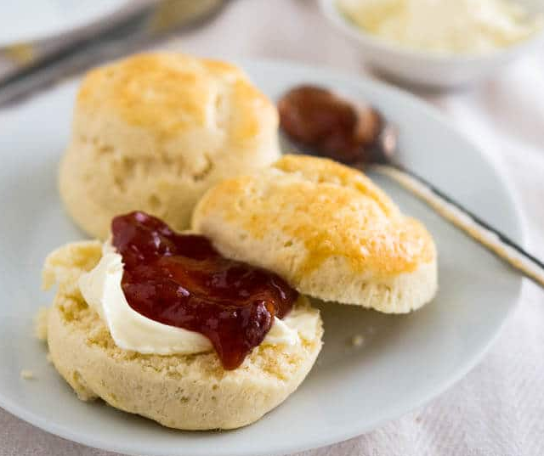

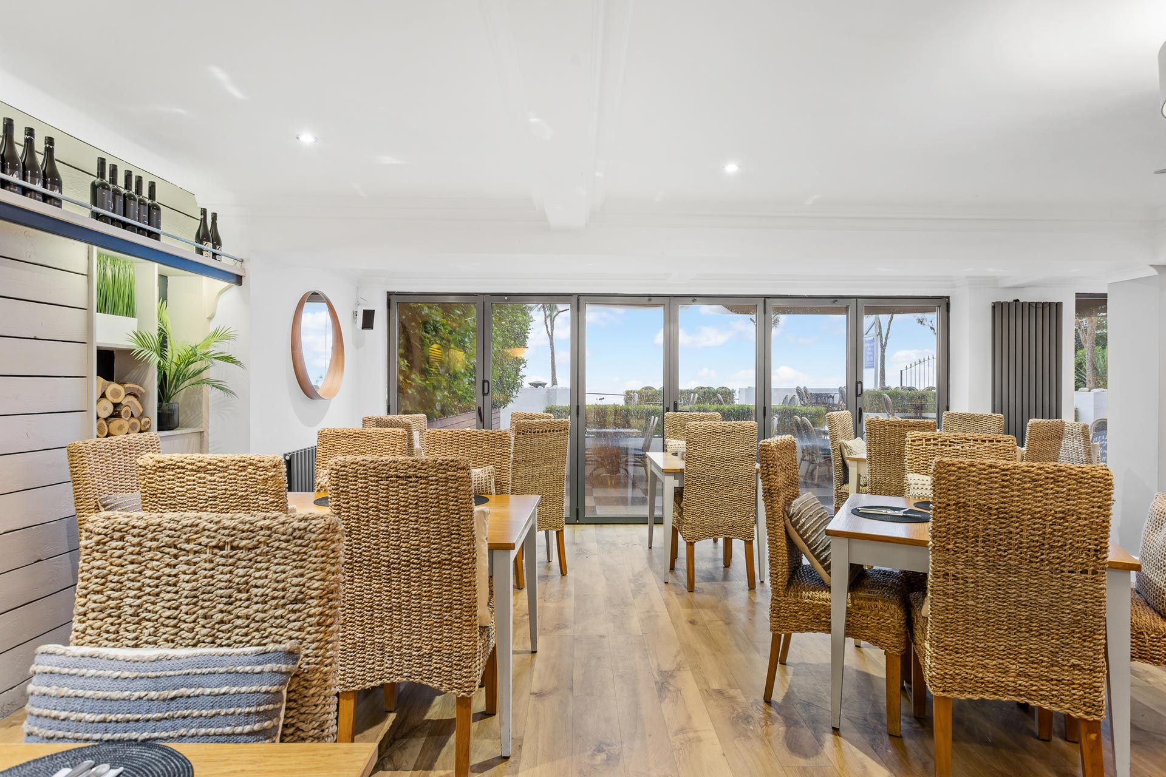
Mood Board
Notes:
The mood board reflects the cafés
With a clean modern design surrounded by natural seaside colours.

Slide 29
Section 3
Redesign to overcome issues
You can view the final designs with this link
https://www.figma.com/proto/CuV8lFWDzOugJt7QWCxyv4/HCI

Slide 30
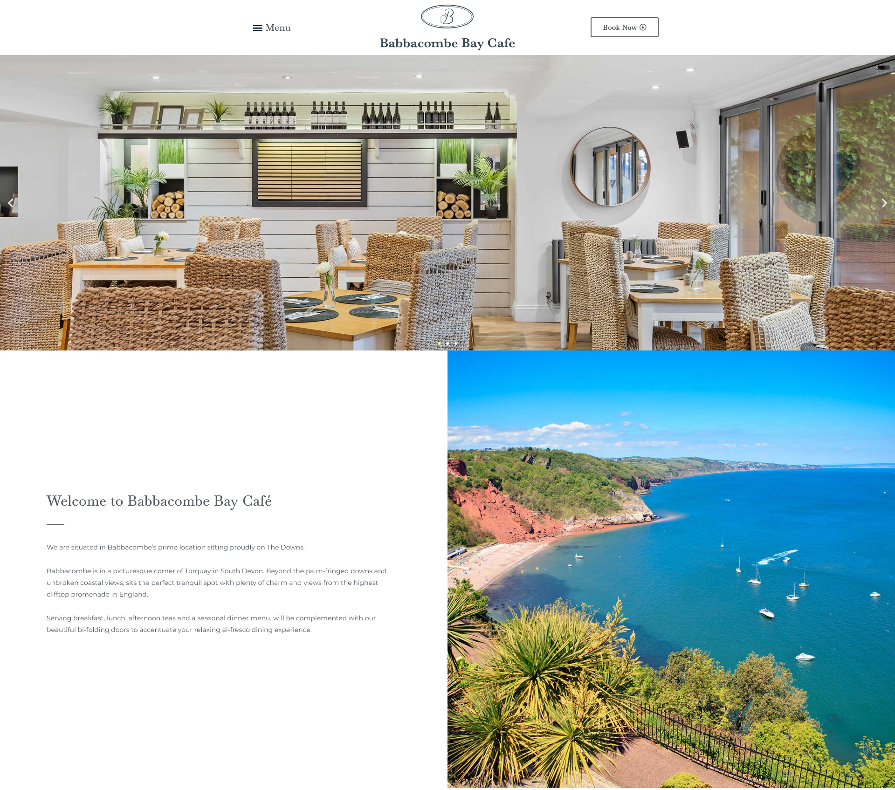
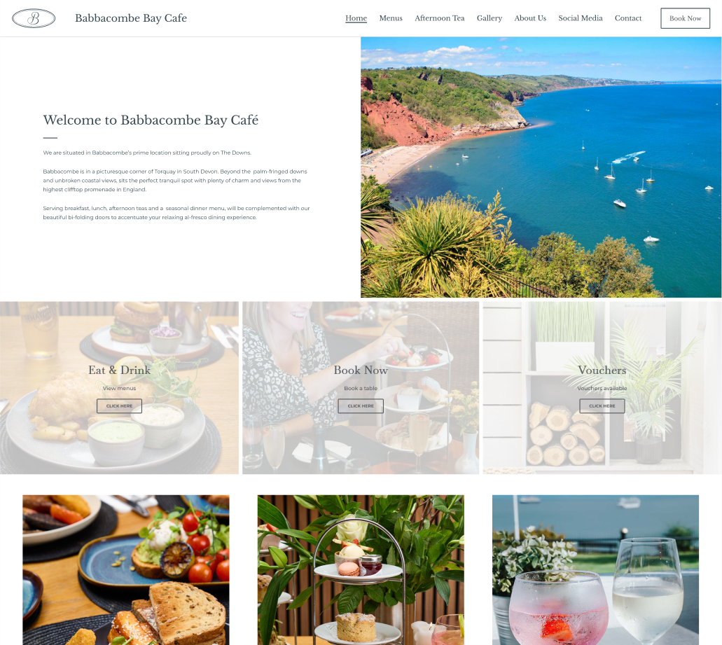
Header
Before
After
Notes:
Header height condensed to take up less space

Slide 31
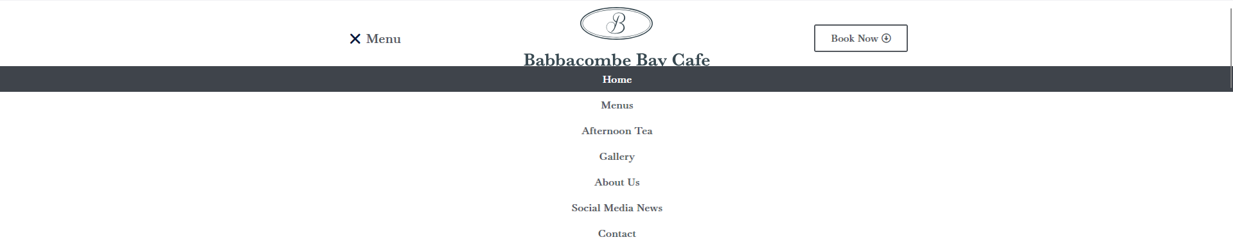
Navigation Menu
Before
After
Notes:
The navigation menu has been brought out taking up less space

Slide 32
Page Identification
Before
After
Notes:
The current page has now been underlined to help the user immediately identify the page they are on

Slide 33
Page Combination
Before
After
Notes:
The About us and Contact page have been combined together
to make navigation and finding information easier for the user

Slide 34
Booking Button
Before
After
Notes:
The book now has become bigger to draw attention to it

Slide 35
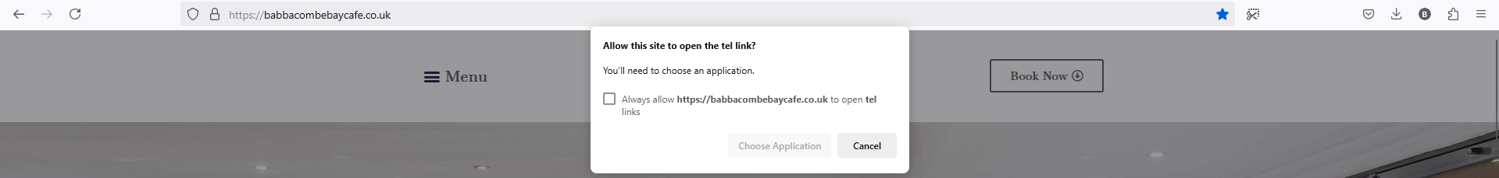
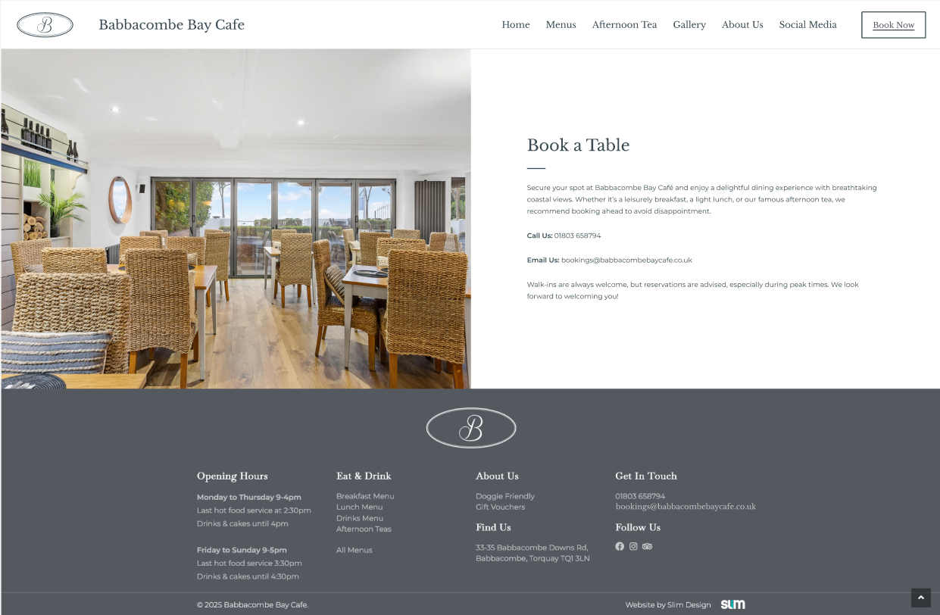
Booking Process
Before
After
Notes:
When pressed It no longer tries to open another application but takes you to a book now page

Slide 36
Booking Process – Option 1
Before
After
Notes:
That tells the user details of how to book.

Slide 37
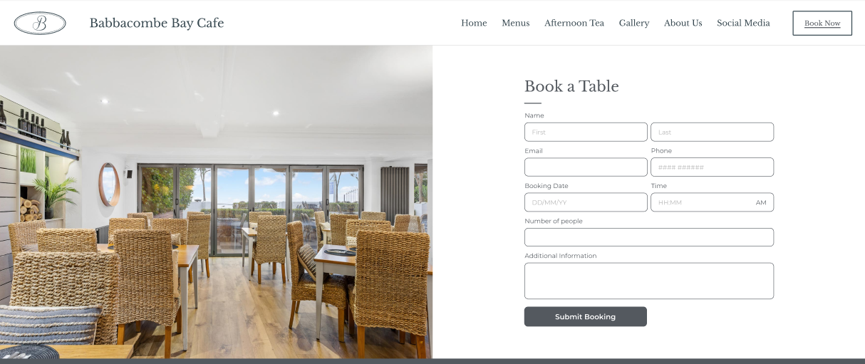
Booking Process – Option 2
Before
After
Notes:
Another option for booking
Is to create a form which the user can easily fill out the details and book without leaving the website.

Slide 38
Booking Process – Option 2
Before
After
Notes:
Another option for booking
Is to create a form which the user can easily fill out the details and book without leaving the website.

Slide 39
Header Image
Before
After
Notes:
The header image was removed on every page to reduce scrolling
And get to the main content more effectively

Slide 40
Image Size
Before
After
Notes:
And the images height was reduced to minimise the white space
This reduction is kept consistent across all of the pages

Slide 41
Font Size
Before
After
Notes:
The font size throughout every page also increased.
Which decreases the empty space and makes it more readable to users

Slide 42
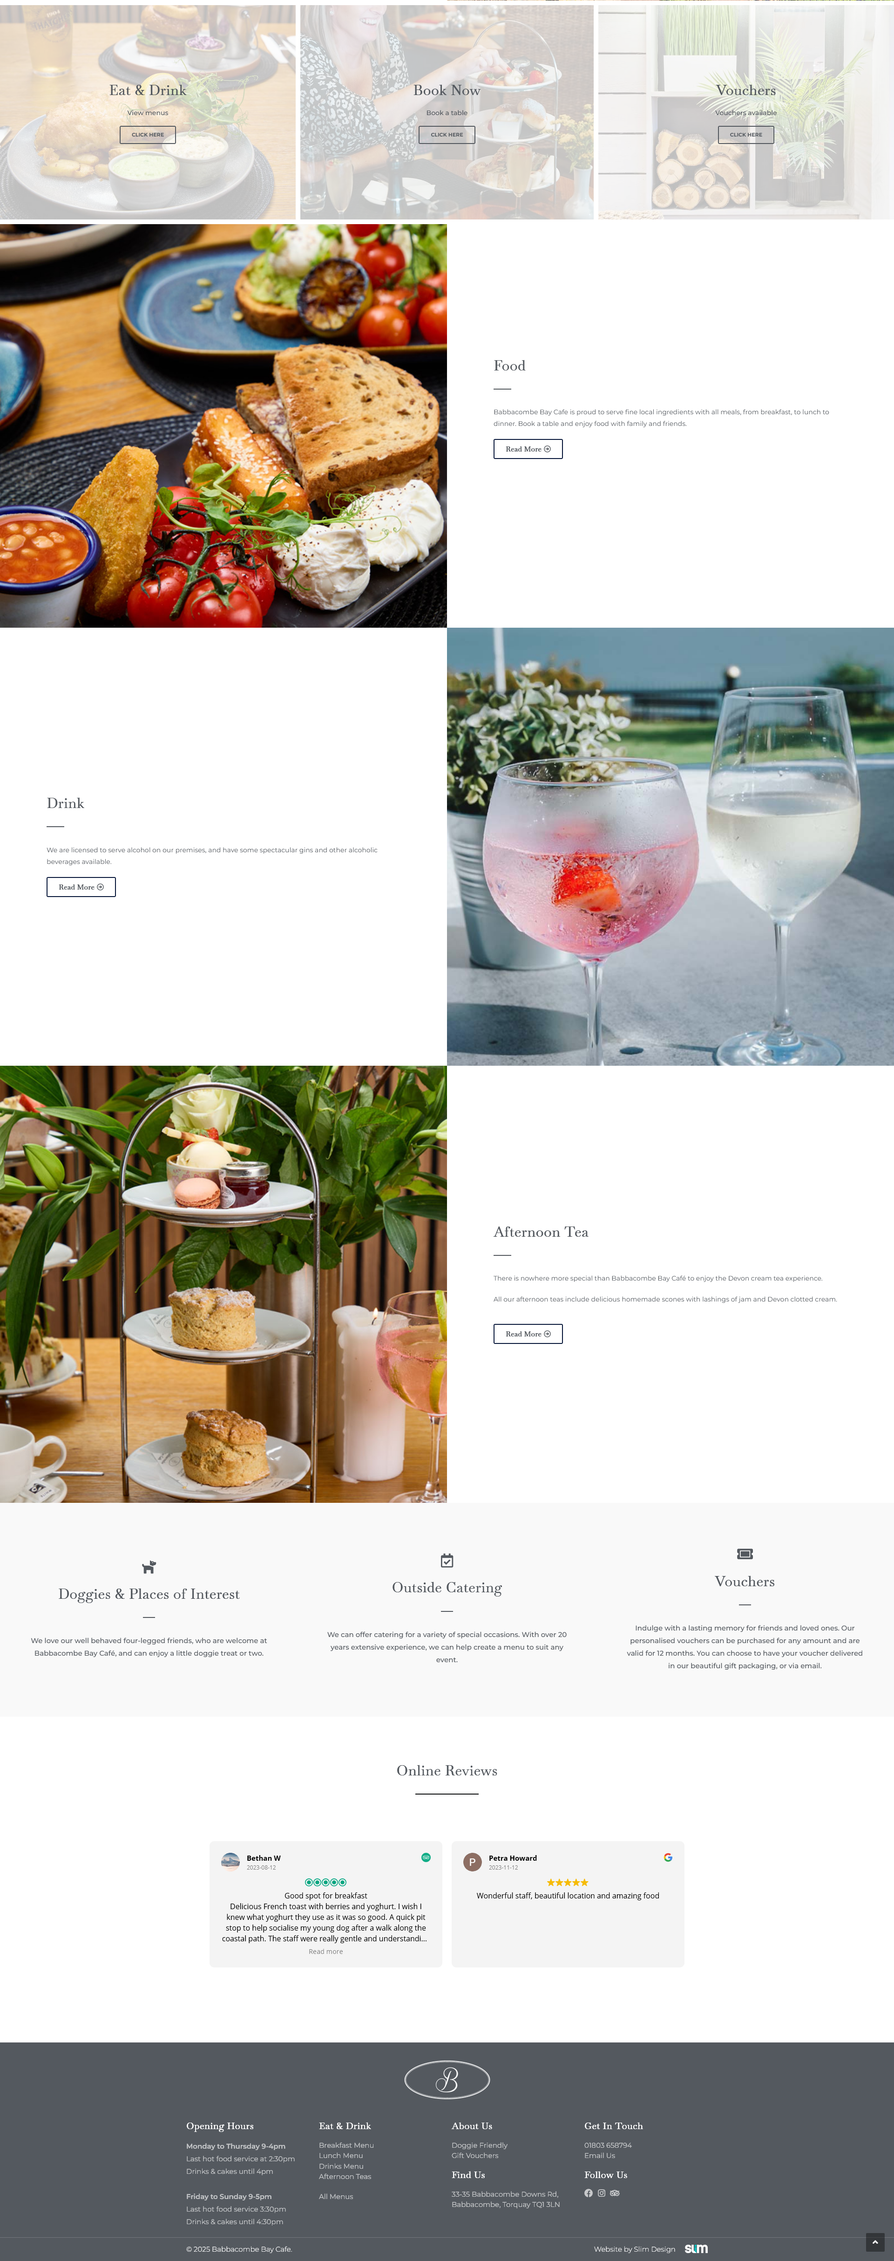
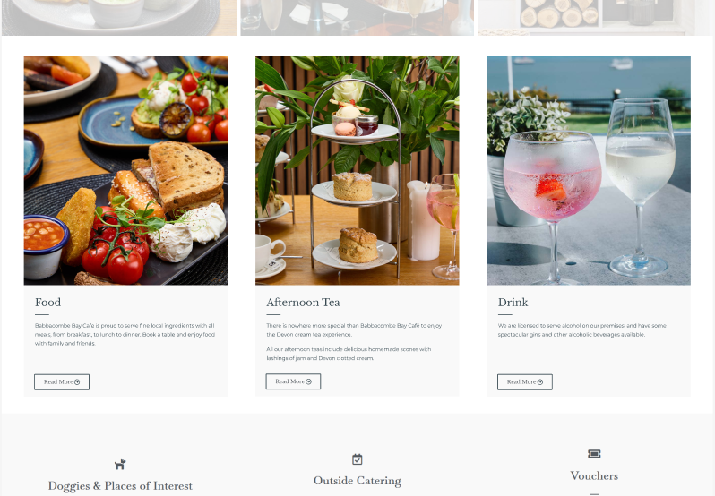
Home Images
Before
After
Notes:
The home page layout was changed to empty space
and needless scrolling

Slide 43
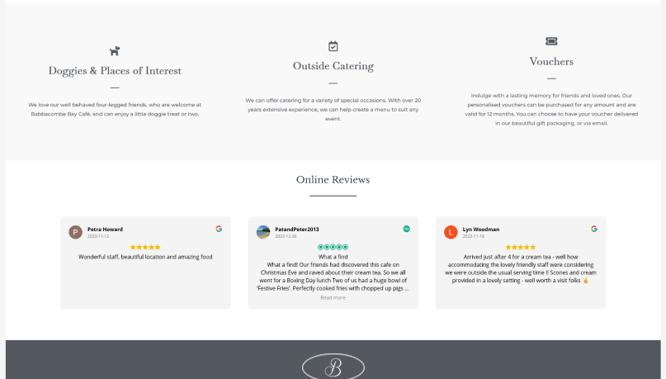
Reviews Space
Before
After
Notes:
The reviews area was compacted

Slide 44
Reviews
Before
After
Notes:
And the number of reviews shown at once was increased.
Filling up the space and allowing users to see more at once

Slide 45
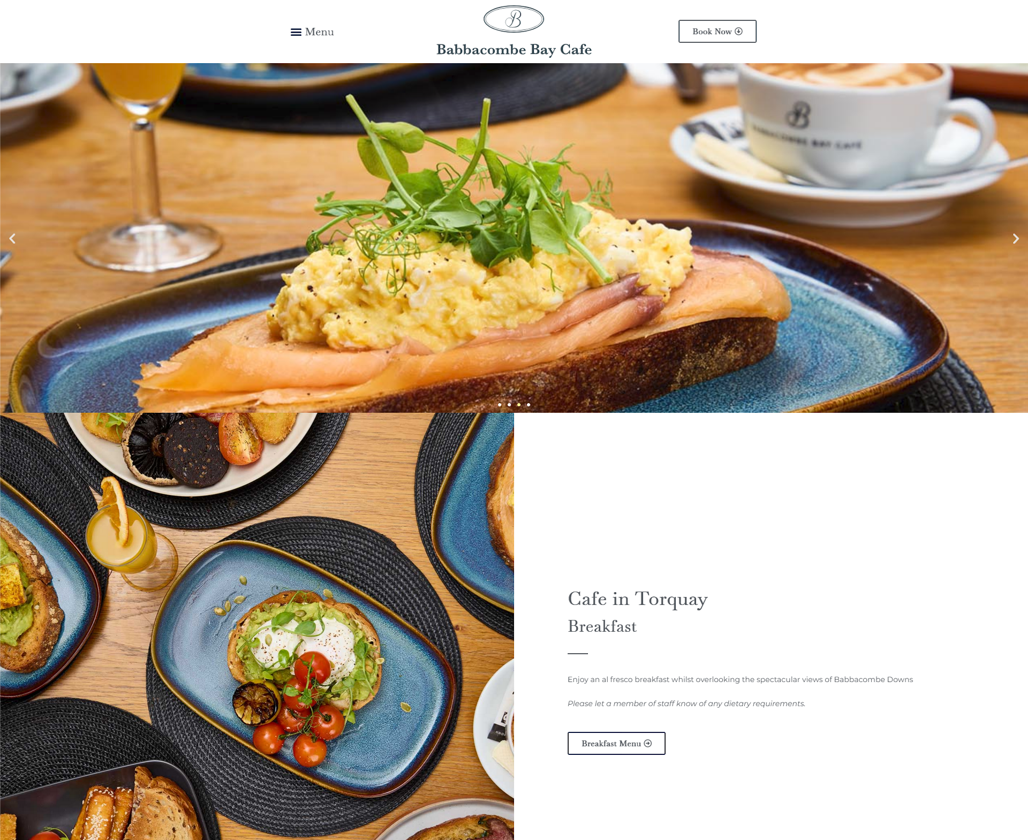
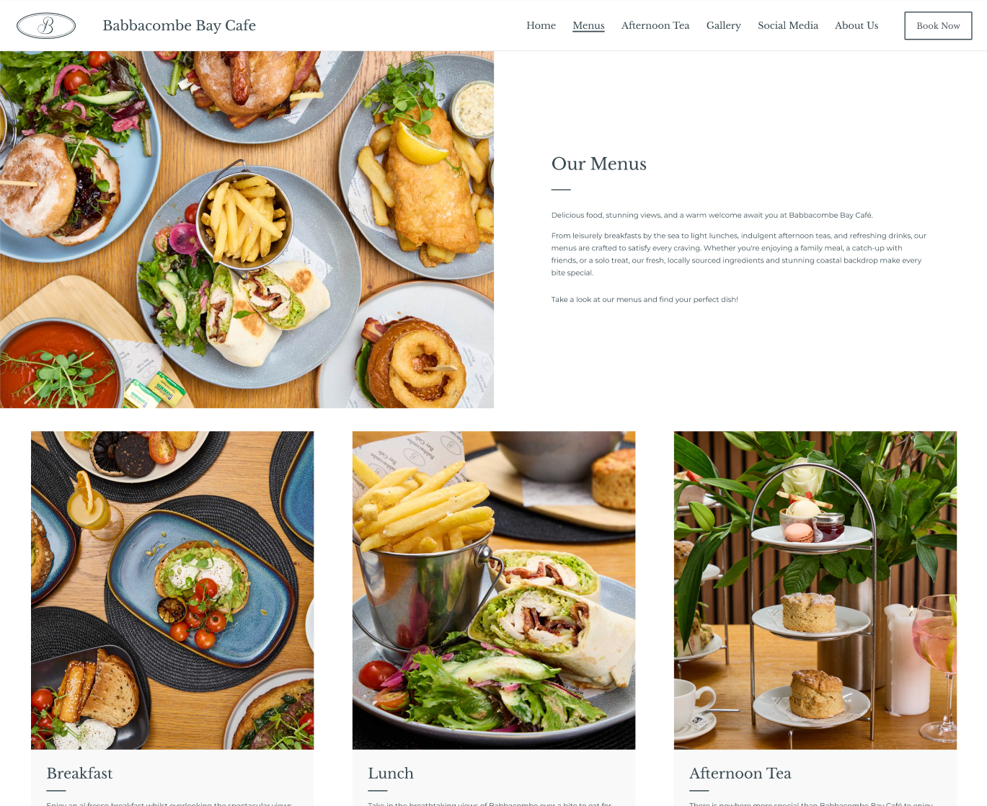
Header Information
Before
After
Notes:
Replaced header with general information tab
So that it the title is separate from the breakfast menu

Slide 46
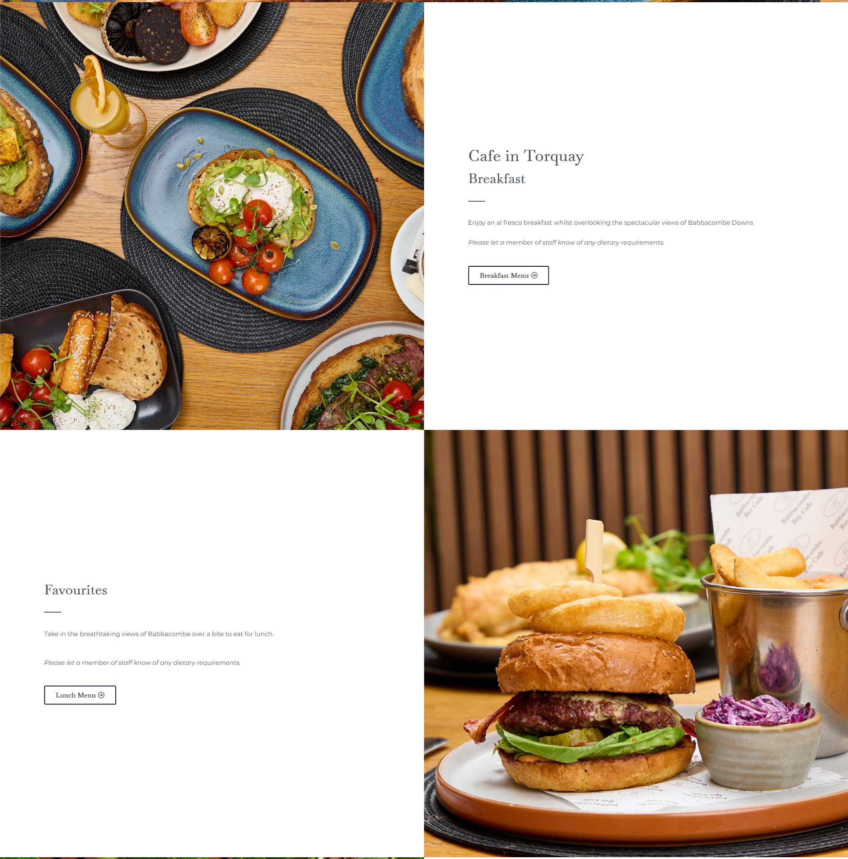
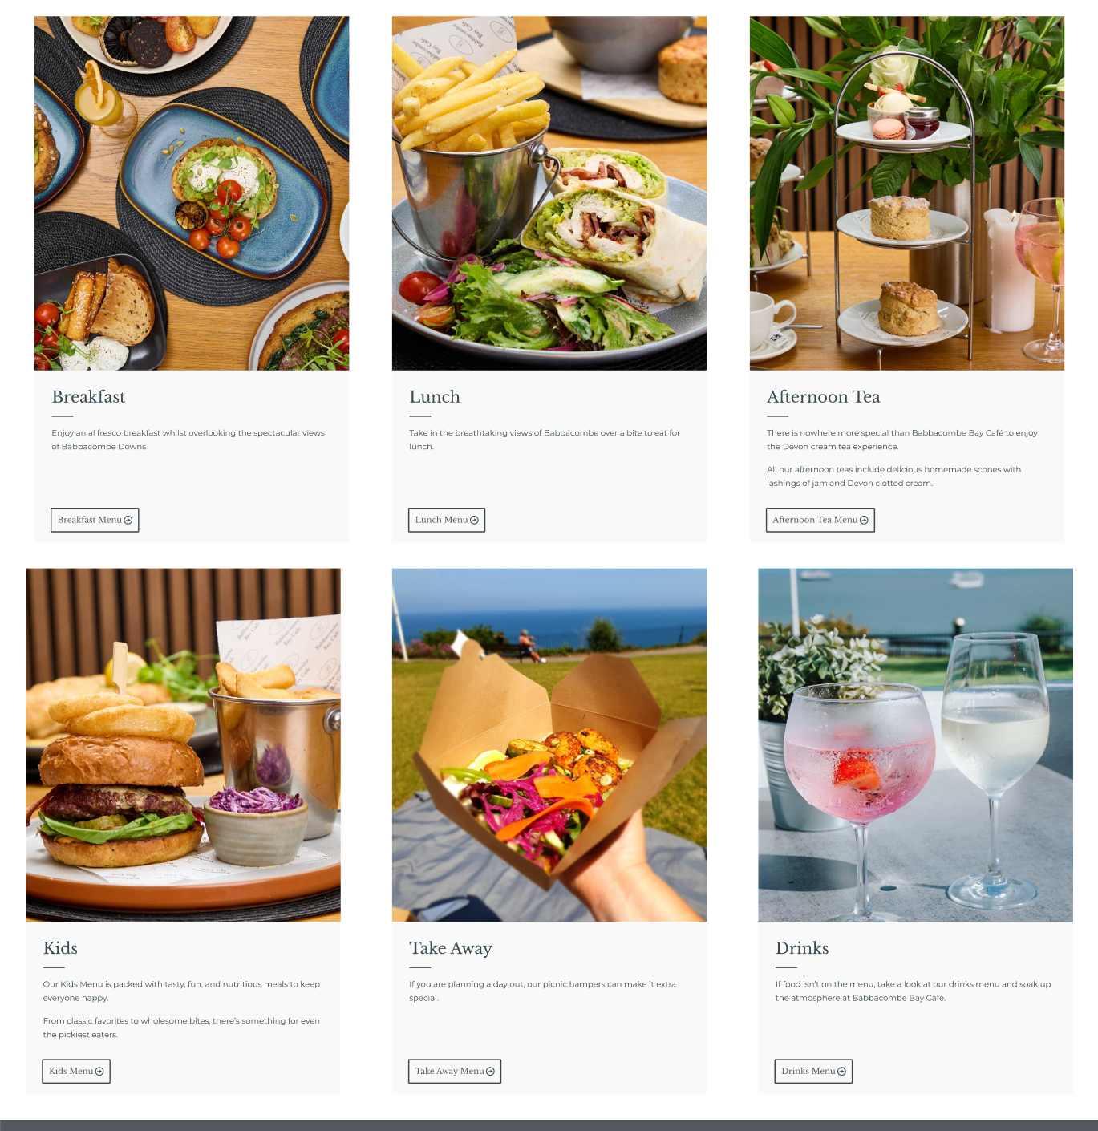
Menu Layout
Before
After
Notes:
Menu layout was changed and made consistent with the home menu.
This reduces empty space and scrolling

Slide 47
Menu Labels
Before
After
Notes:
The favourites was changed to accurately label the lunch section

Slide 48
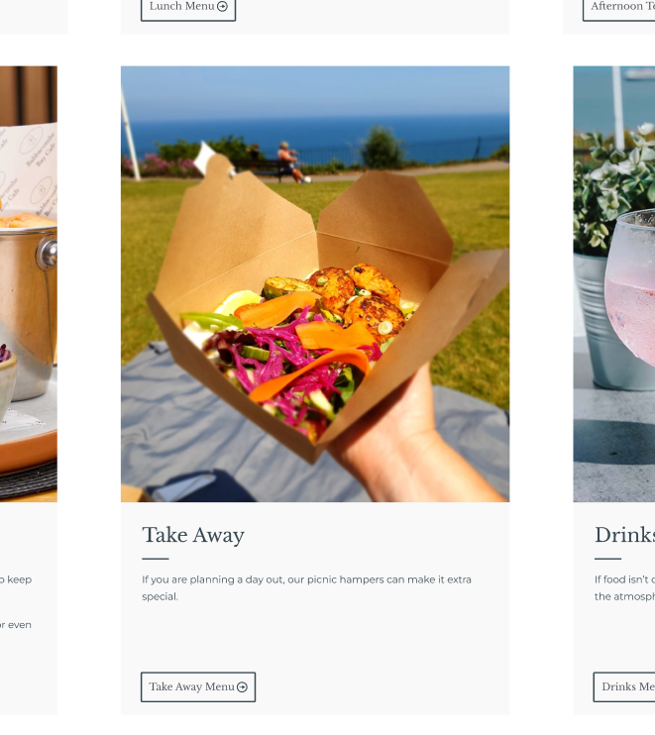
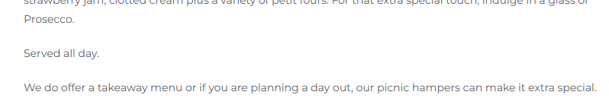
Menu Labels
Before
After
Notes:
The takeaway menu which was missing on the website
Has also been added to the menu page for the users to see

Slide 49




Header
Before
After
Notes:
The lunch menus image was changed so it isn’t the same as the kid's menu

Slide 50
Kids Menu Information
Before
After
Notes:
And a description was added to the kid's menu
To provide information to the user

Slide 51
Kids Menu Information
Before
After
Notes:
And a description was added to the kid's menu
To provide information to the user

Slide 52


Afternoon Tea Page
Before
After
Notes:
The afternoon tea pages menu was brought onto the page
With a consistent layout as the menu and home

Slide 53
Take Away
Before
After
Notes:
And the takeaway menu was added to the page for quick access to the afternoon tea takeout menu

Slide 54


Vouchers
On Home Page
After
Notes:
The vouchers were also advertised in this section
To bring more attention to them they are given their own place on the afternoon tea page

Slide 55


Repetition
Before About Us
After
Notes:
The repeated elements from the home page were removed
Condensing the content on the combined about us page

Slide 56


Map Location Space
Before Contact
After
Notes:
The maps empty space was reduced down

Slide 57
Map Location Zoom
Before Contact
After
Notes:
And the map itself starts off zoomed in slightly further
So that users can get a better understanding of its surroundings

Slide 58


Map Location Zoom
Before About Us
After
Notes:
The header image was moved to the about us section to give a more personal touch

Slide 59


Map Location Zoom
Before Contact
After
Notes:
And the empty message us section was replaced with an image

Slide 60


Map Location Zoom
Before Contact
After
Notes:
The location address was removed as the location is displayed underneath with the find us map

Slide 61



Email
Before Contact
After
Before Footer
After Footer
Notes:
I also replace the “email us” on both the get in touch section and the footer
With the full email address so that the users can directly see it

Slide 62
Redesign
Babbacombe Bay Café:
https://babbacombebaycafe.co.uk/
Redesign:
https://www.figma.com/proto/CuV8lFWDzOugJt7QWCxyv4/HCI
Notes:
You can see the original website and all of my redesigns by following these links

